Slide 1

PART II – Analysis Tool

Slide 2
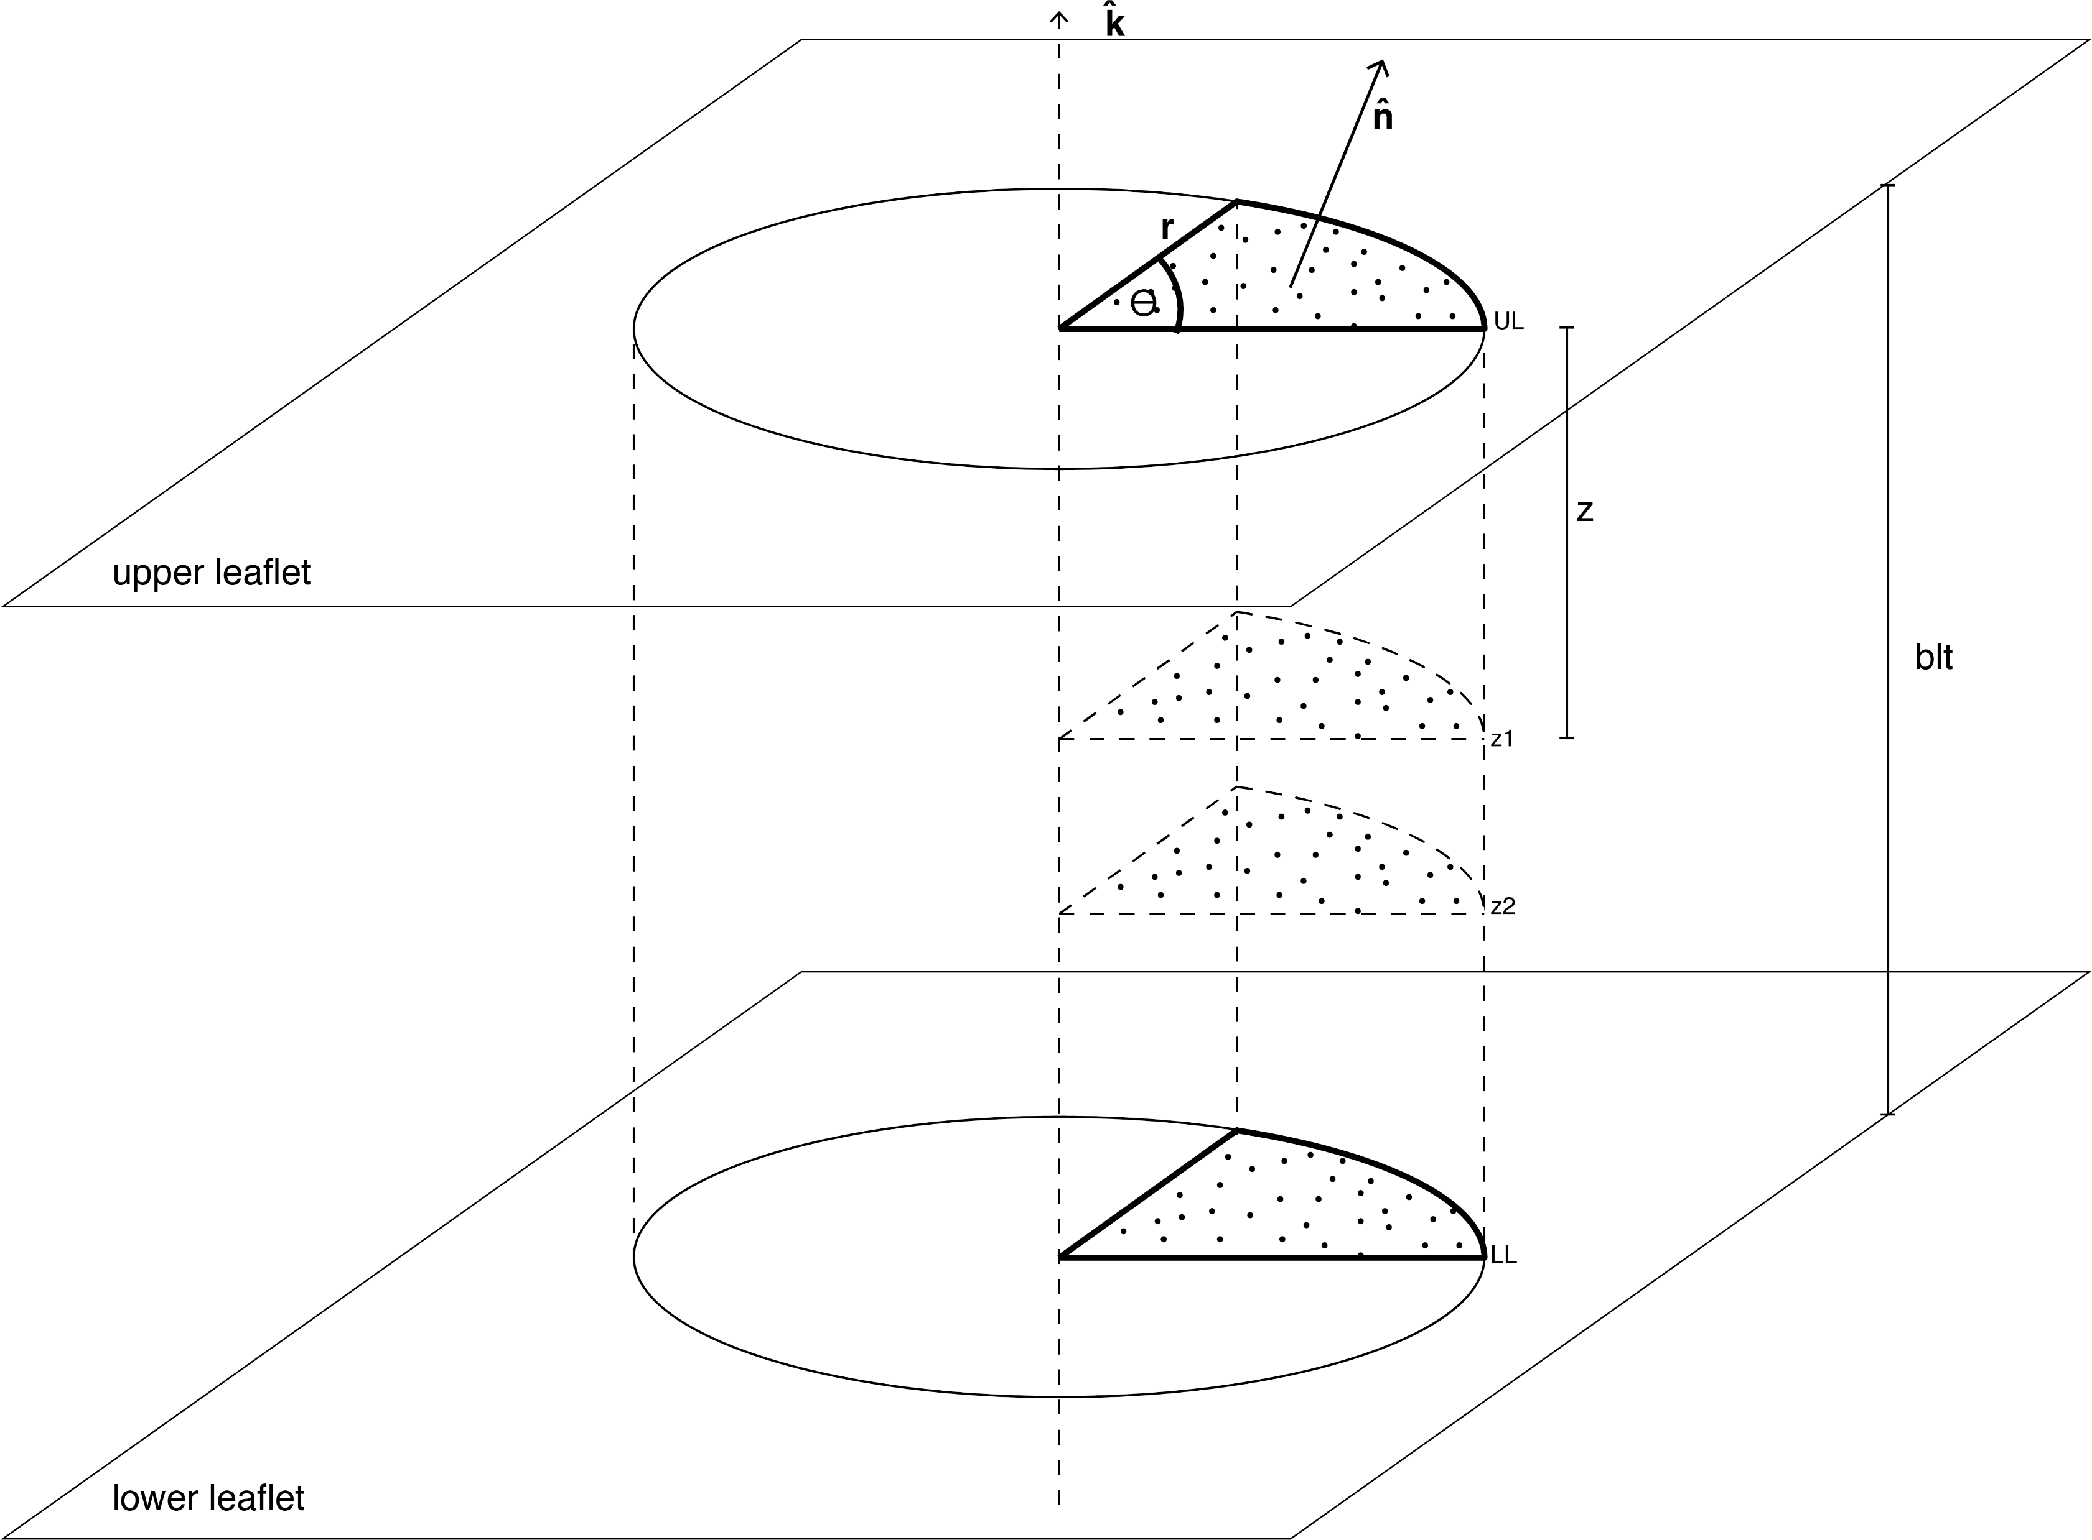
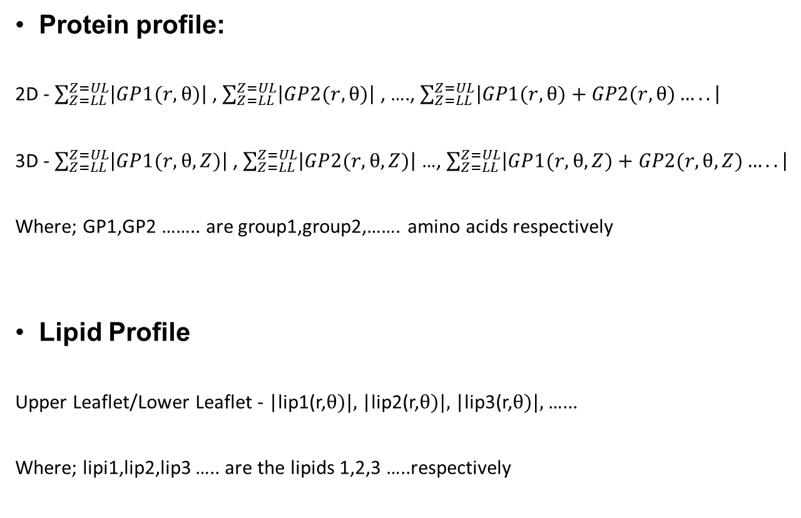
Motivation
Protein profile:
2D - $\sum_{Z=LL}^{Z=UL}{\left|GP1(r,θ)\right|}$ , $\sum_{Z=LL}^{Z=UL}{\left|GP2(r,θ)\right|}$ , …., $\sum_{Z=LL}^{Z=UL}{\left|GP1(r,θ)+GP2(r,θ)…..\right|}$
3D - $\sum_{Z=LL}^{Z=UL}{\left|GP1(r,θ,Z)\right|}$ , $\sum_{Z=LL}^{Z=UL}{\left|GP2(r,θ,Z)\right|}$ …, $\sum_{Z=LL}^{Z=UL}{\left|GP1(r,θ,Z)+GP2(r,θ,Z)…..\right|}$
Where; GP1,GP2 …….. are group1,group2,……. amino acids respectively
Lipid Profile
Upper Leaflet/Lower Leaflet - |lip1(r,$θ)|,$|lip2(r,$θ)|,$|lip3(r,$θ)|,$ …...
Where; lipi1,lip2,lip3 ….. are the lipids 1,2,3 …..respectively

Slide 3
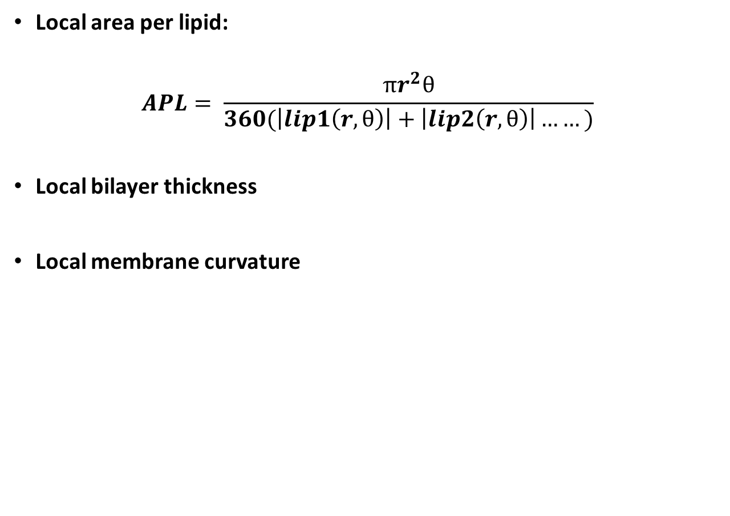
Motivation
Local area per lipid:
$$APL= \frac{πr^{2}θ}{360(\left|lip1\left(r,θ\right)\right|+\left|lip2\left(r,θ\right)\right|……)}$$
Local bilayer thickness
Local membrane curvature

Slide 4
Protein Profiles

Slide 5
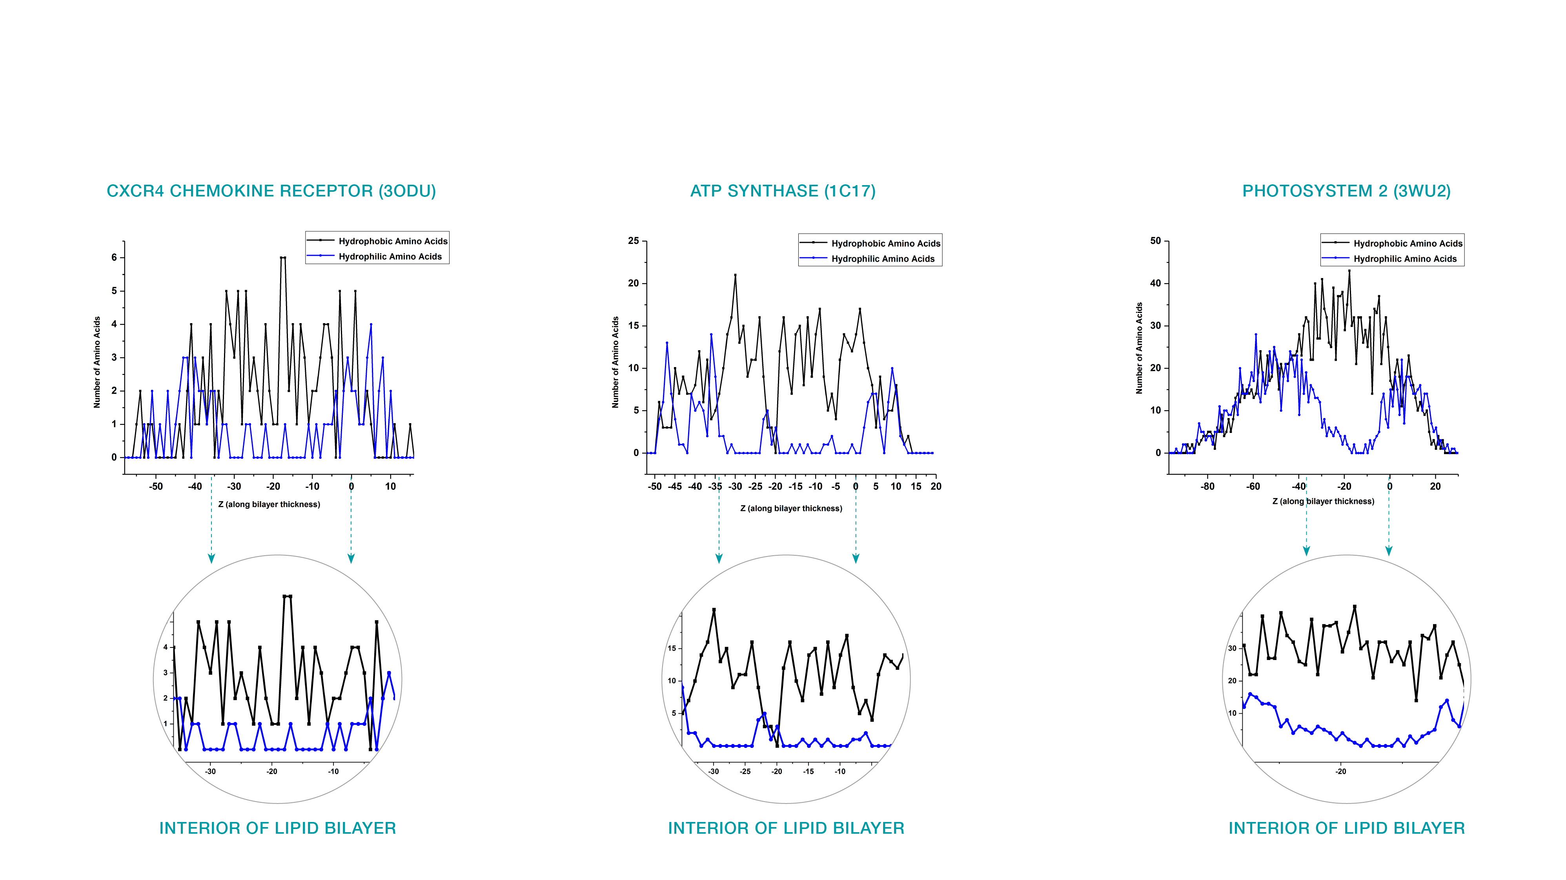
1 Dimensional Protein Profile

Slide 6
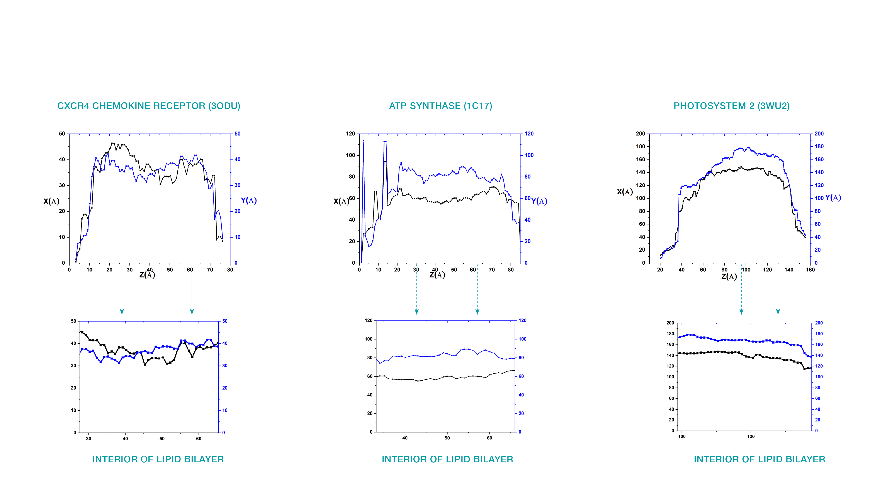
2 Dimensional Protein Profile (Spread)

Slide 7
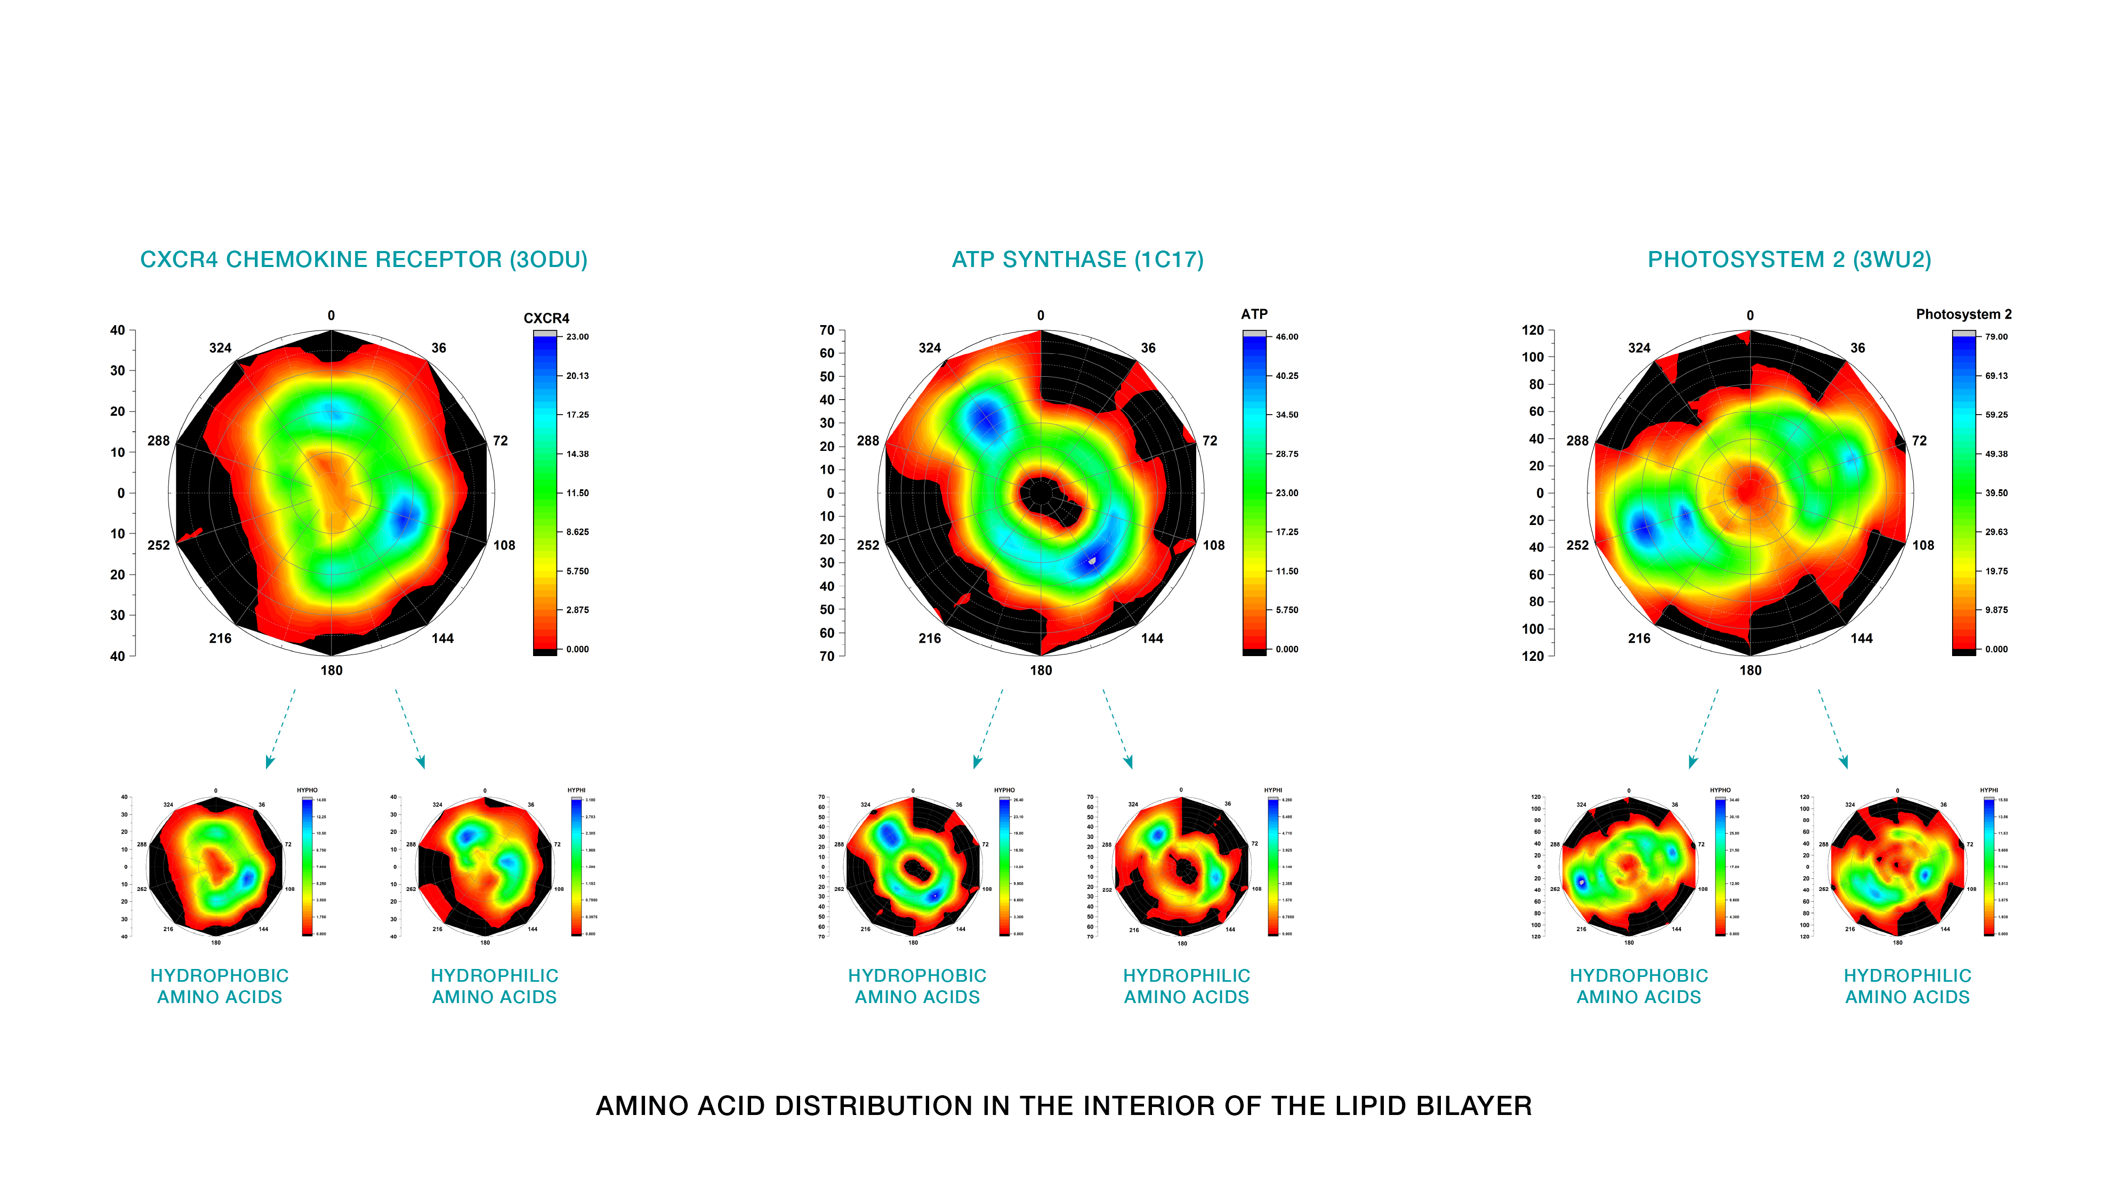
2 Dimensional Protein Profile (Amino Acid Distribution)

Slide 8
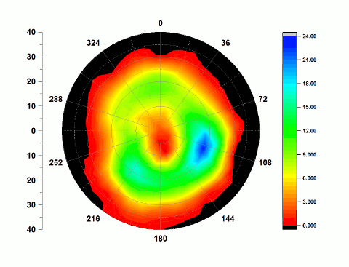
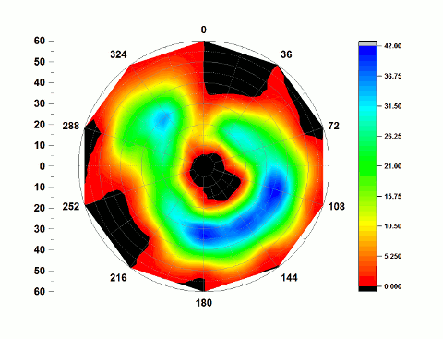
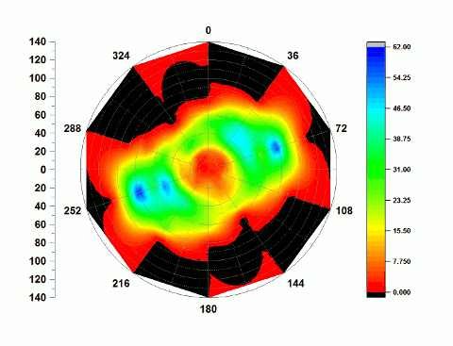
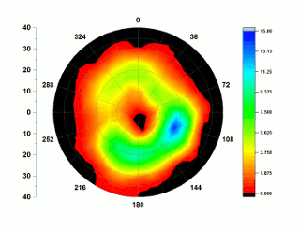
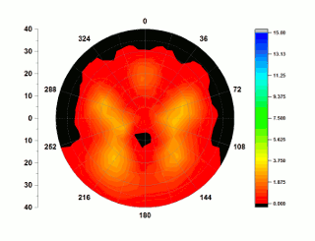
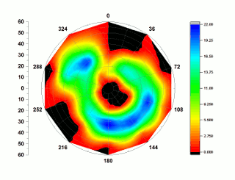
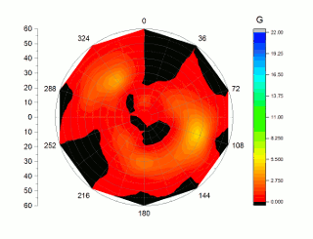
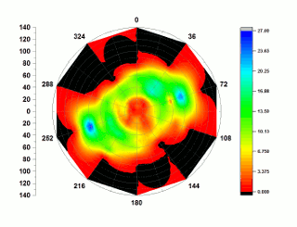
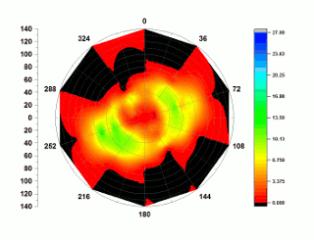
Protein structure evolution
CXCR4 CHEMOKINE RECEPTOR (3ODU)
ATP SYNTHASE (1C17)
PHOTOSYSTEM 2 ( 3WU2)
HYDROPHOBIC AMINO ACIDS
HYDROPHILIC AMINO ACIDS
HYDROPHOBIC AMINO ACIDS
HYDROPHILIC AMINO ACIDS
HYDROPHOBIC AMINO ACIDS
HYDROPHILIC AMINO ACIDS

Slide 9
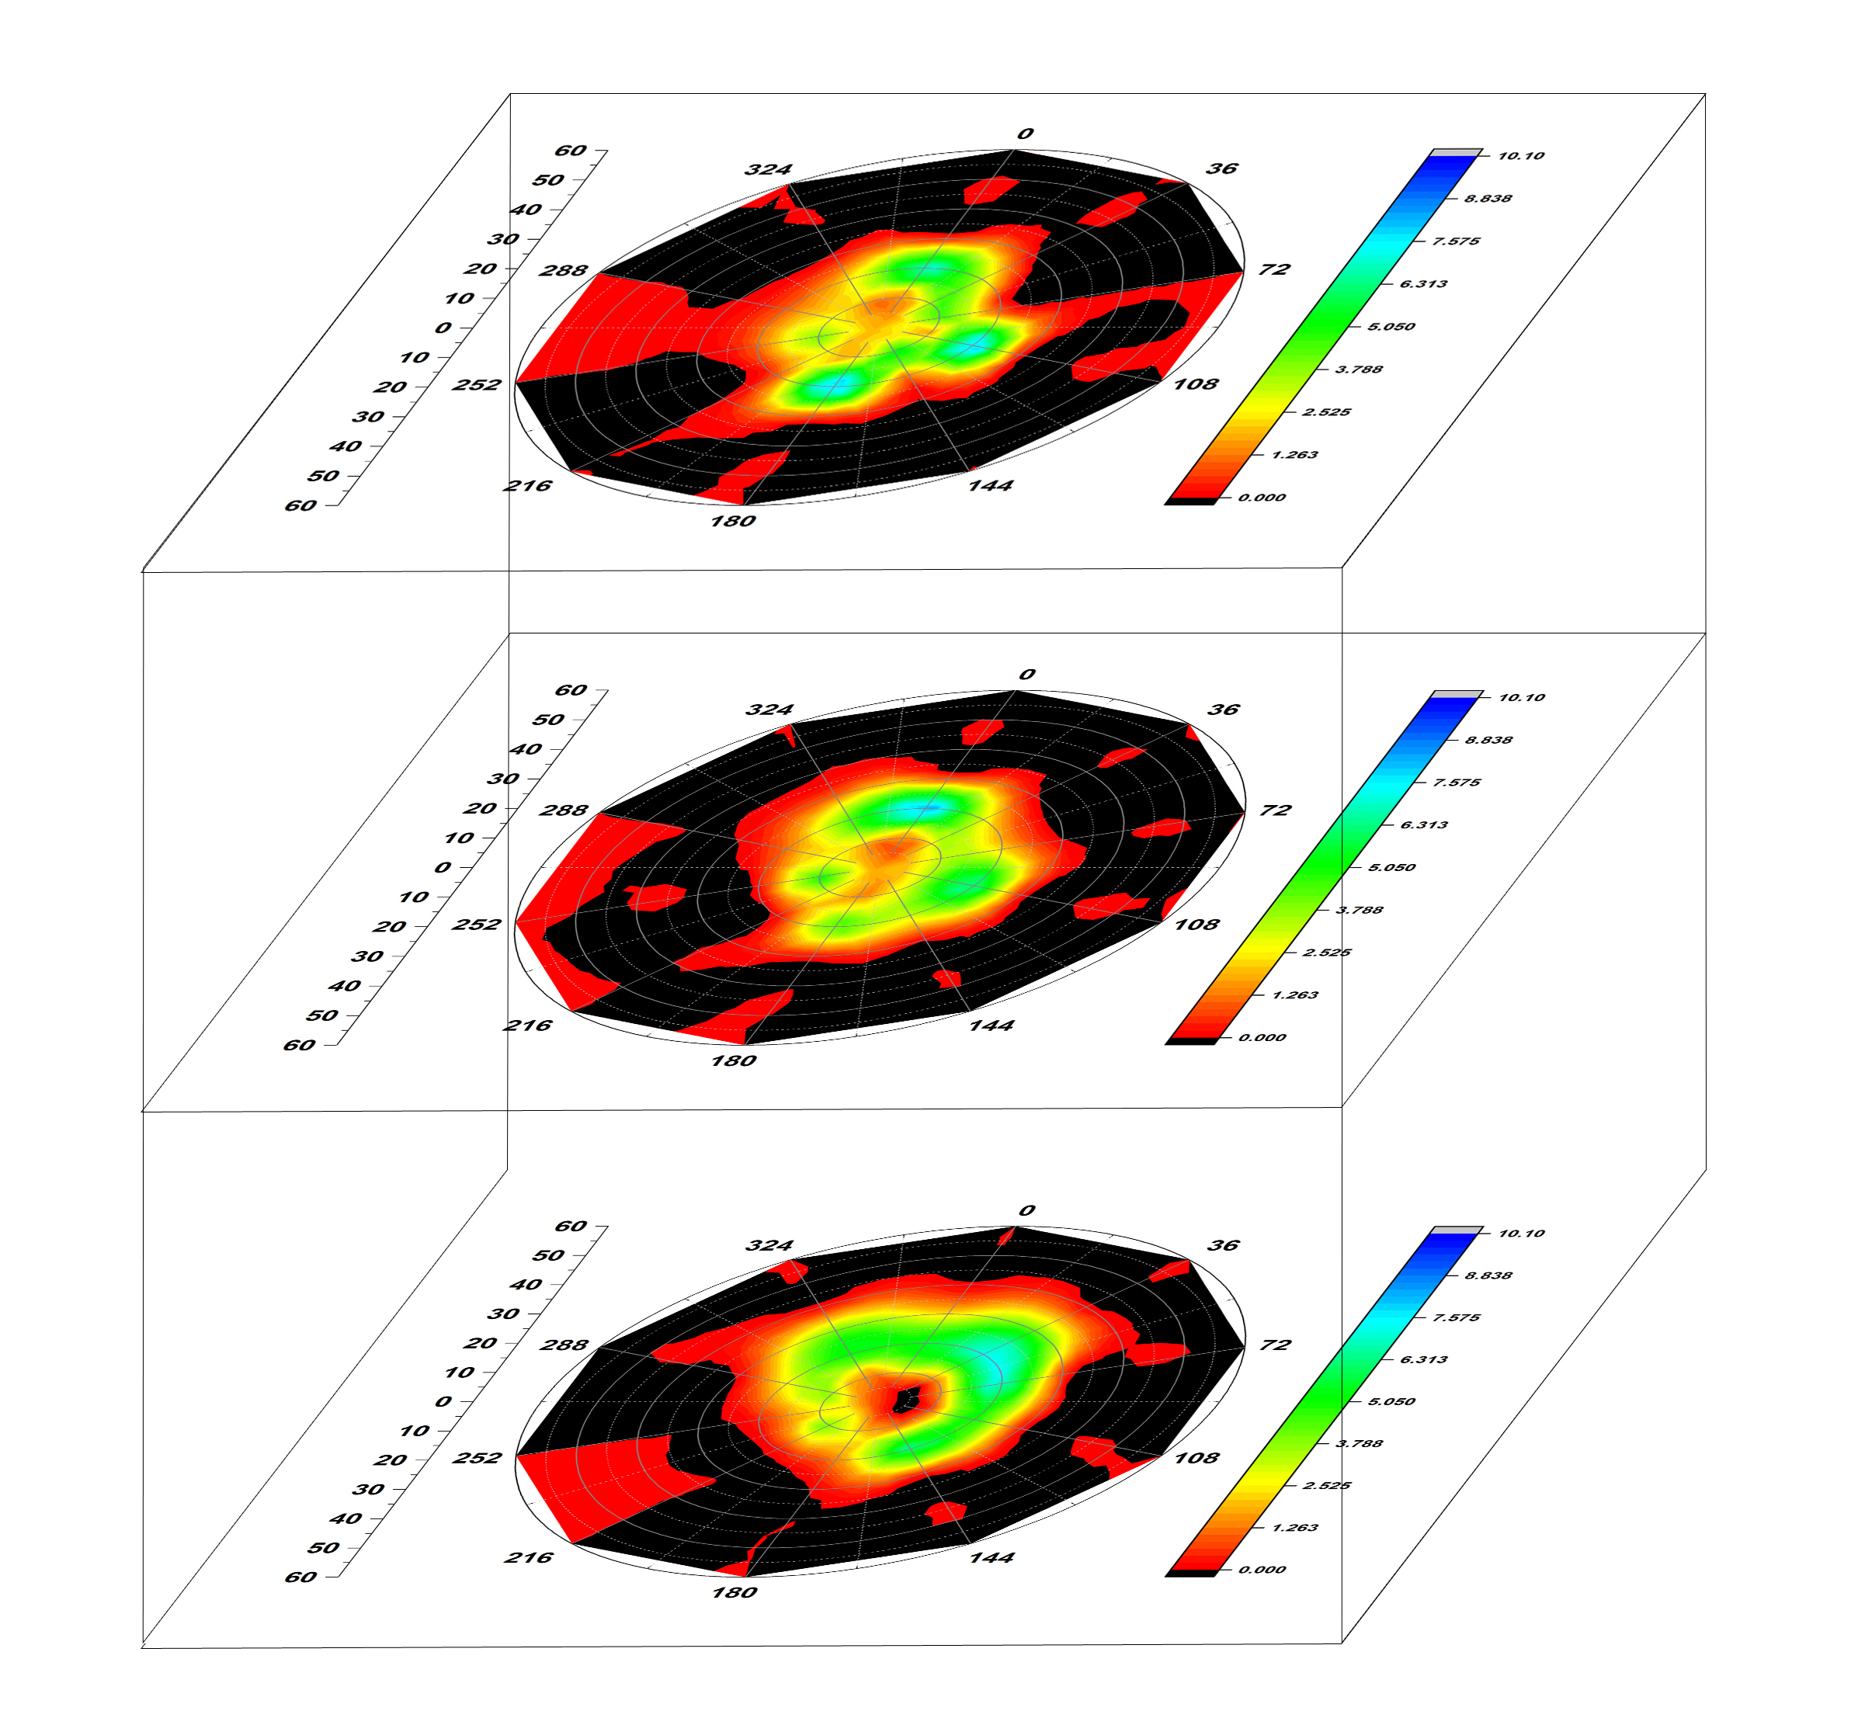
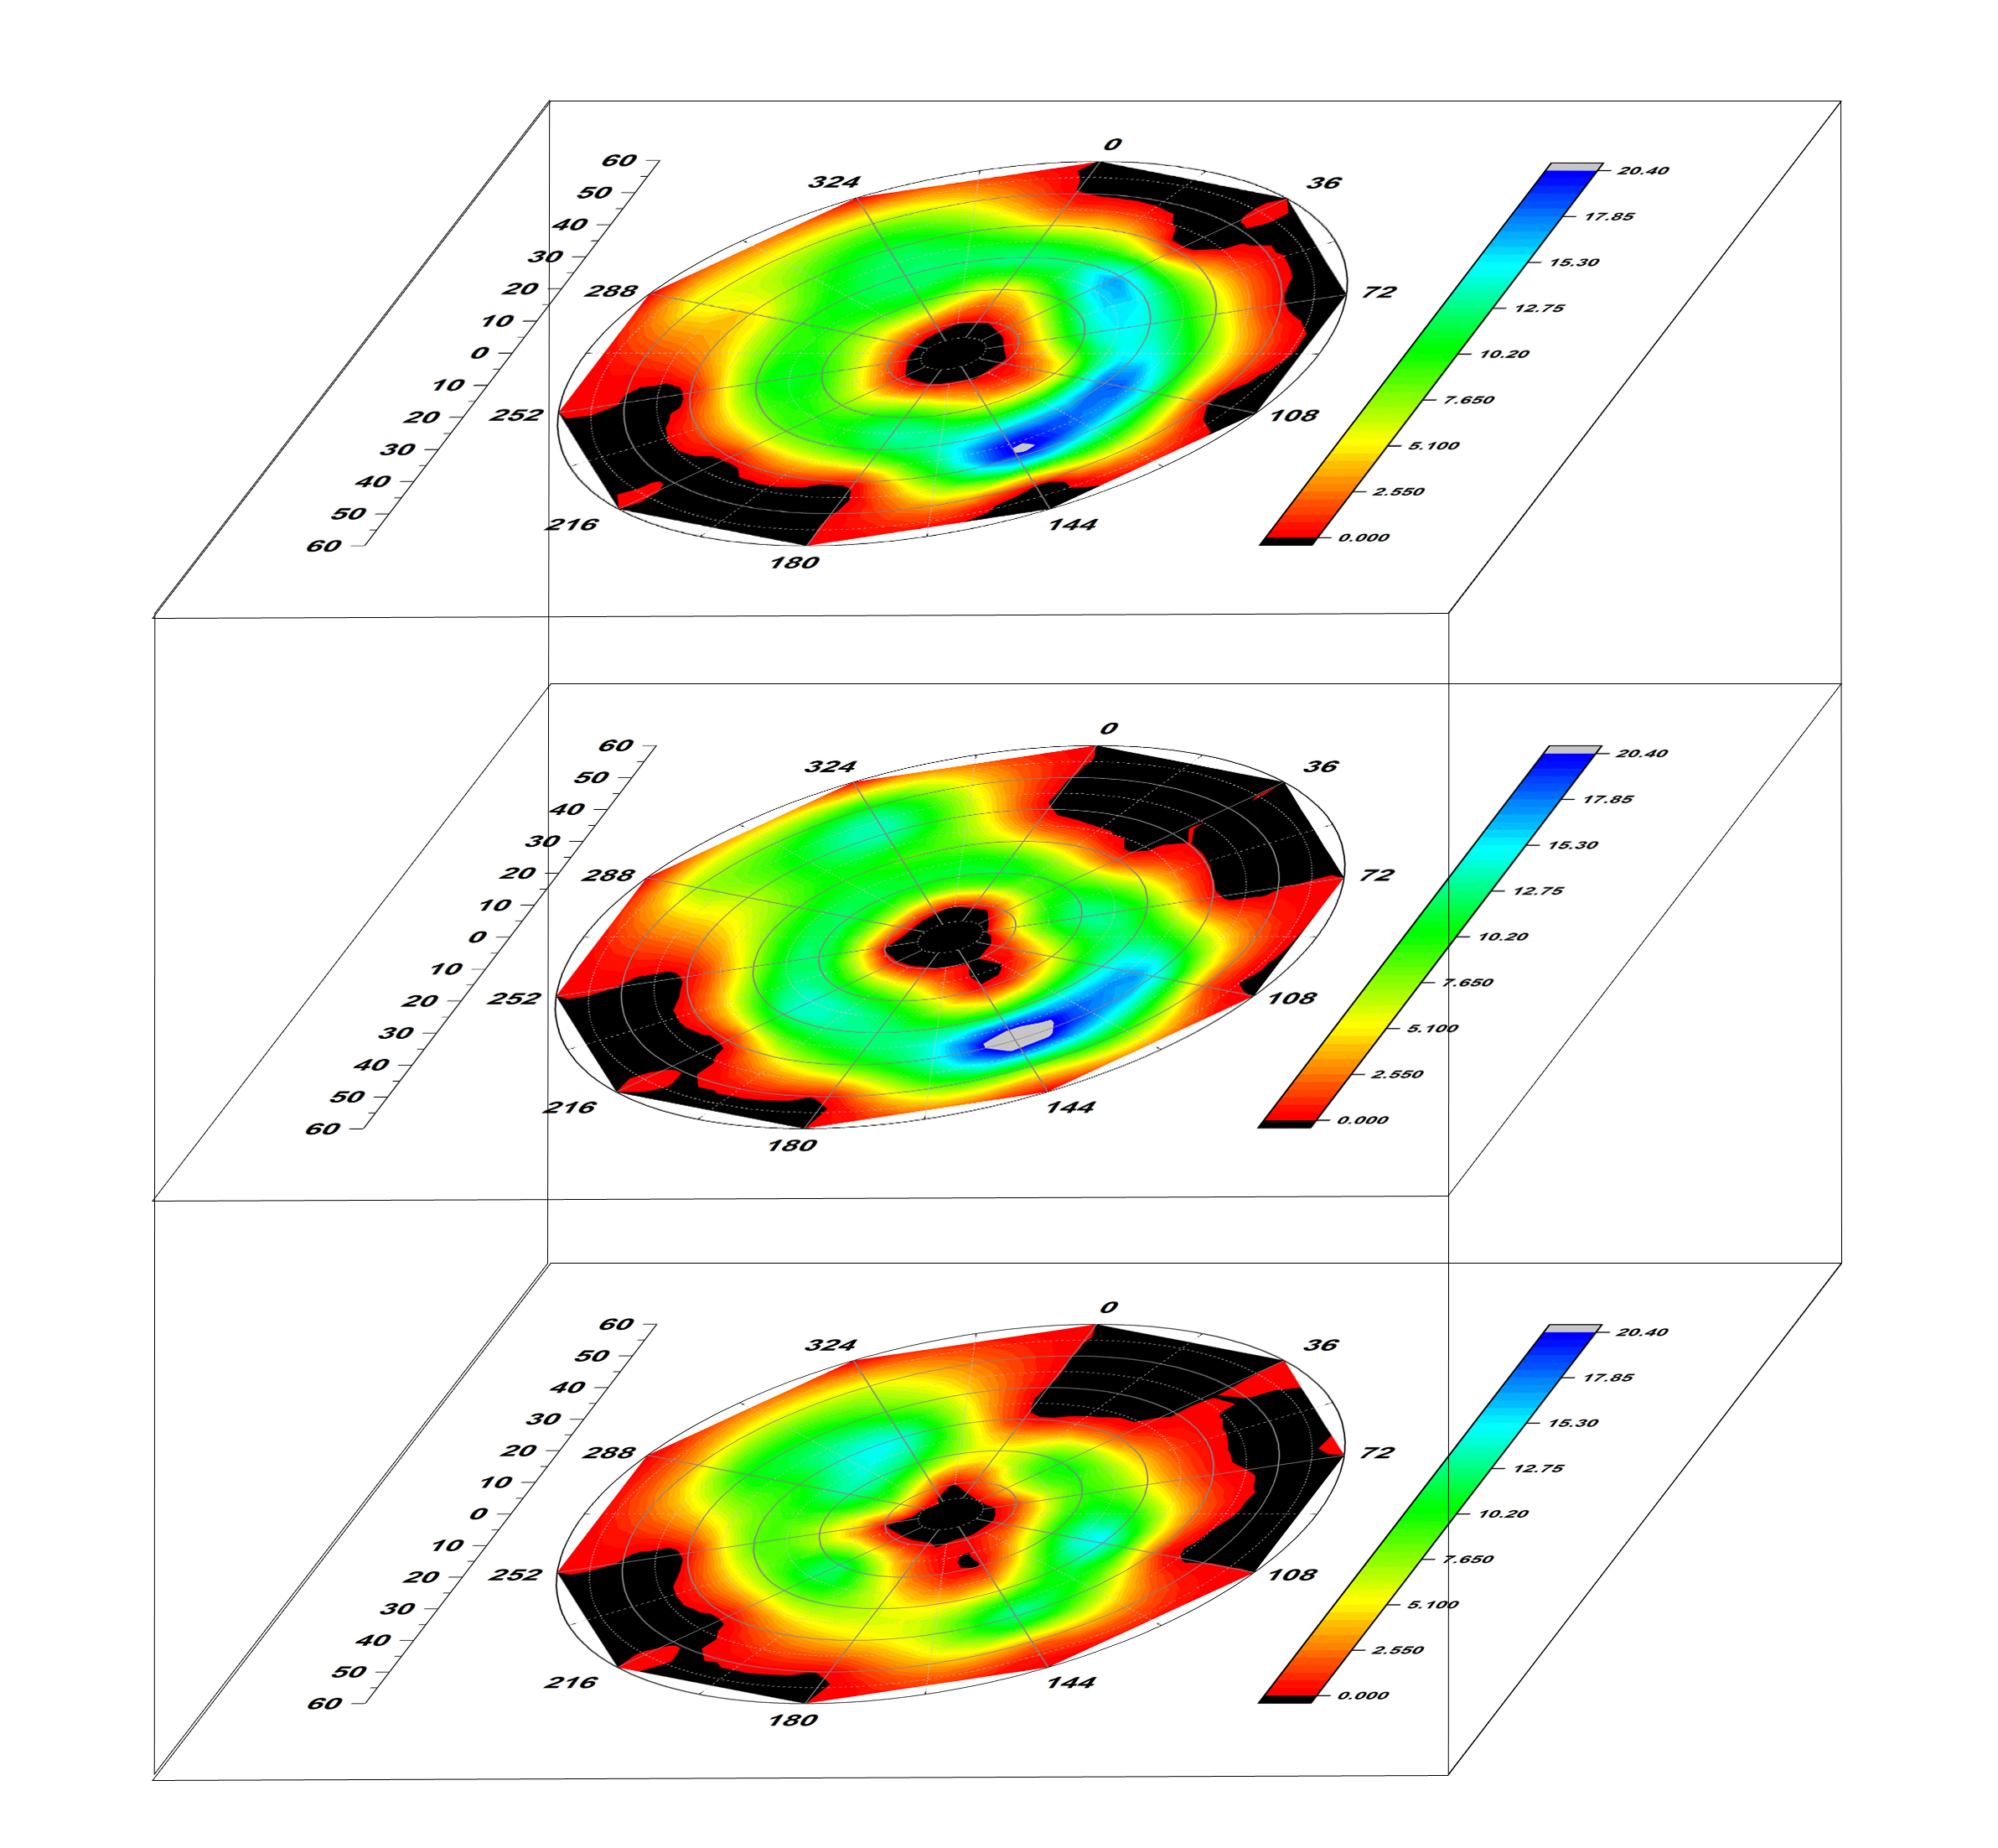
3 Dimensional Protein Profile (Amino Acid Distribution)
CXCR4 CHEMOKINE RECEPTOR (3ODU)
ATP SYNTHASE (1C17)
PHOTOSYSTEM 2 ( 3WU2)

Slide 10
Lipid Profiles

Slide 11
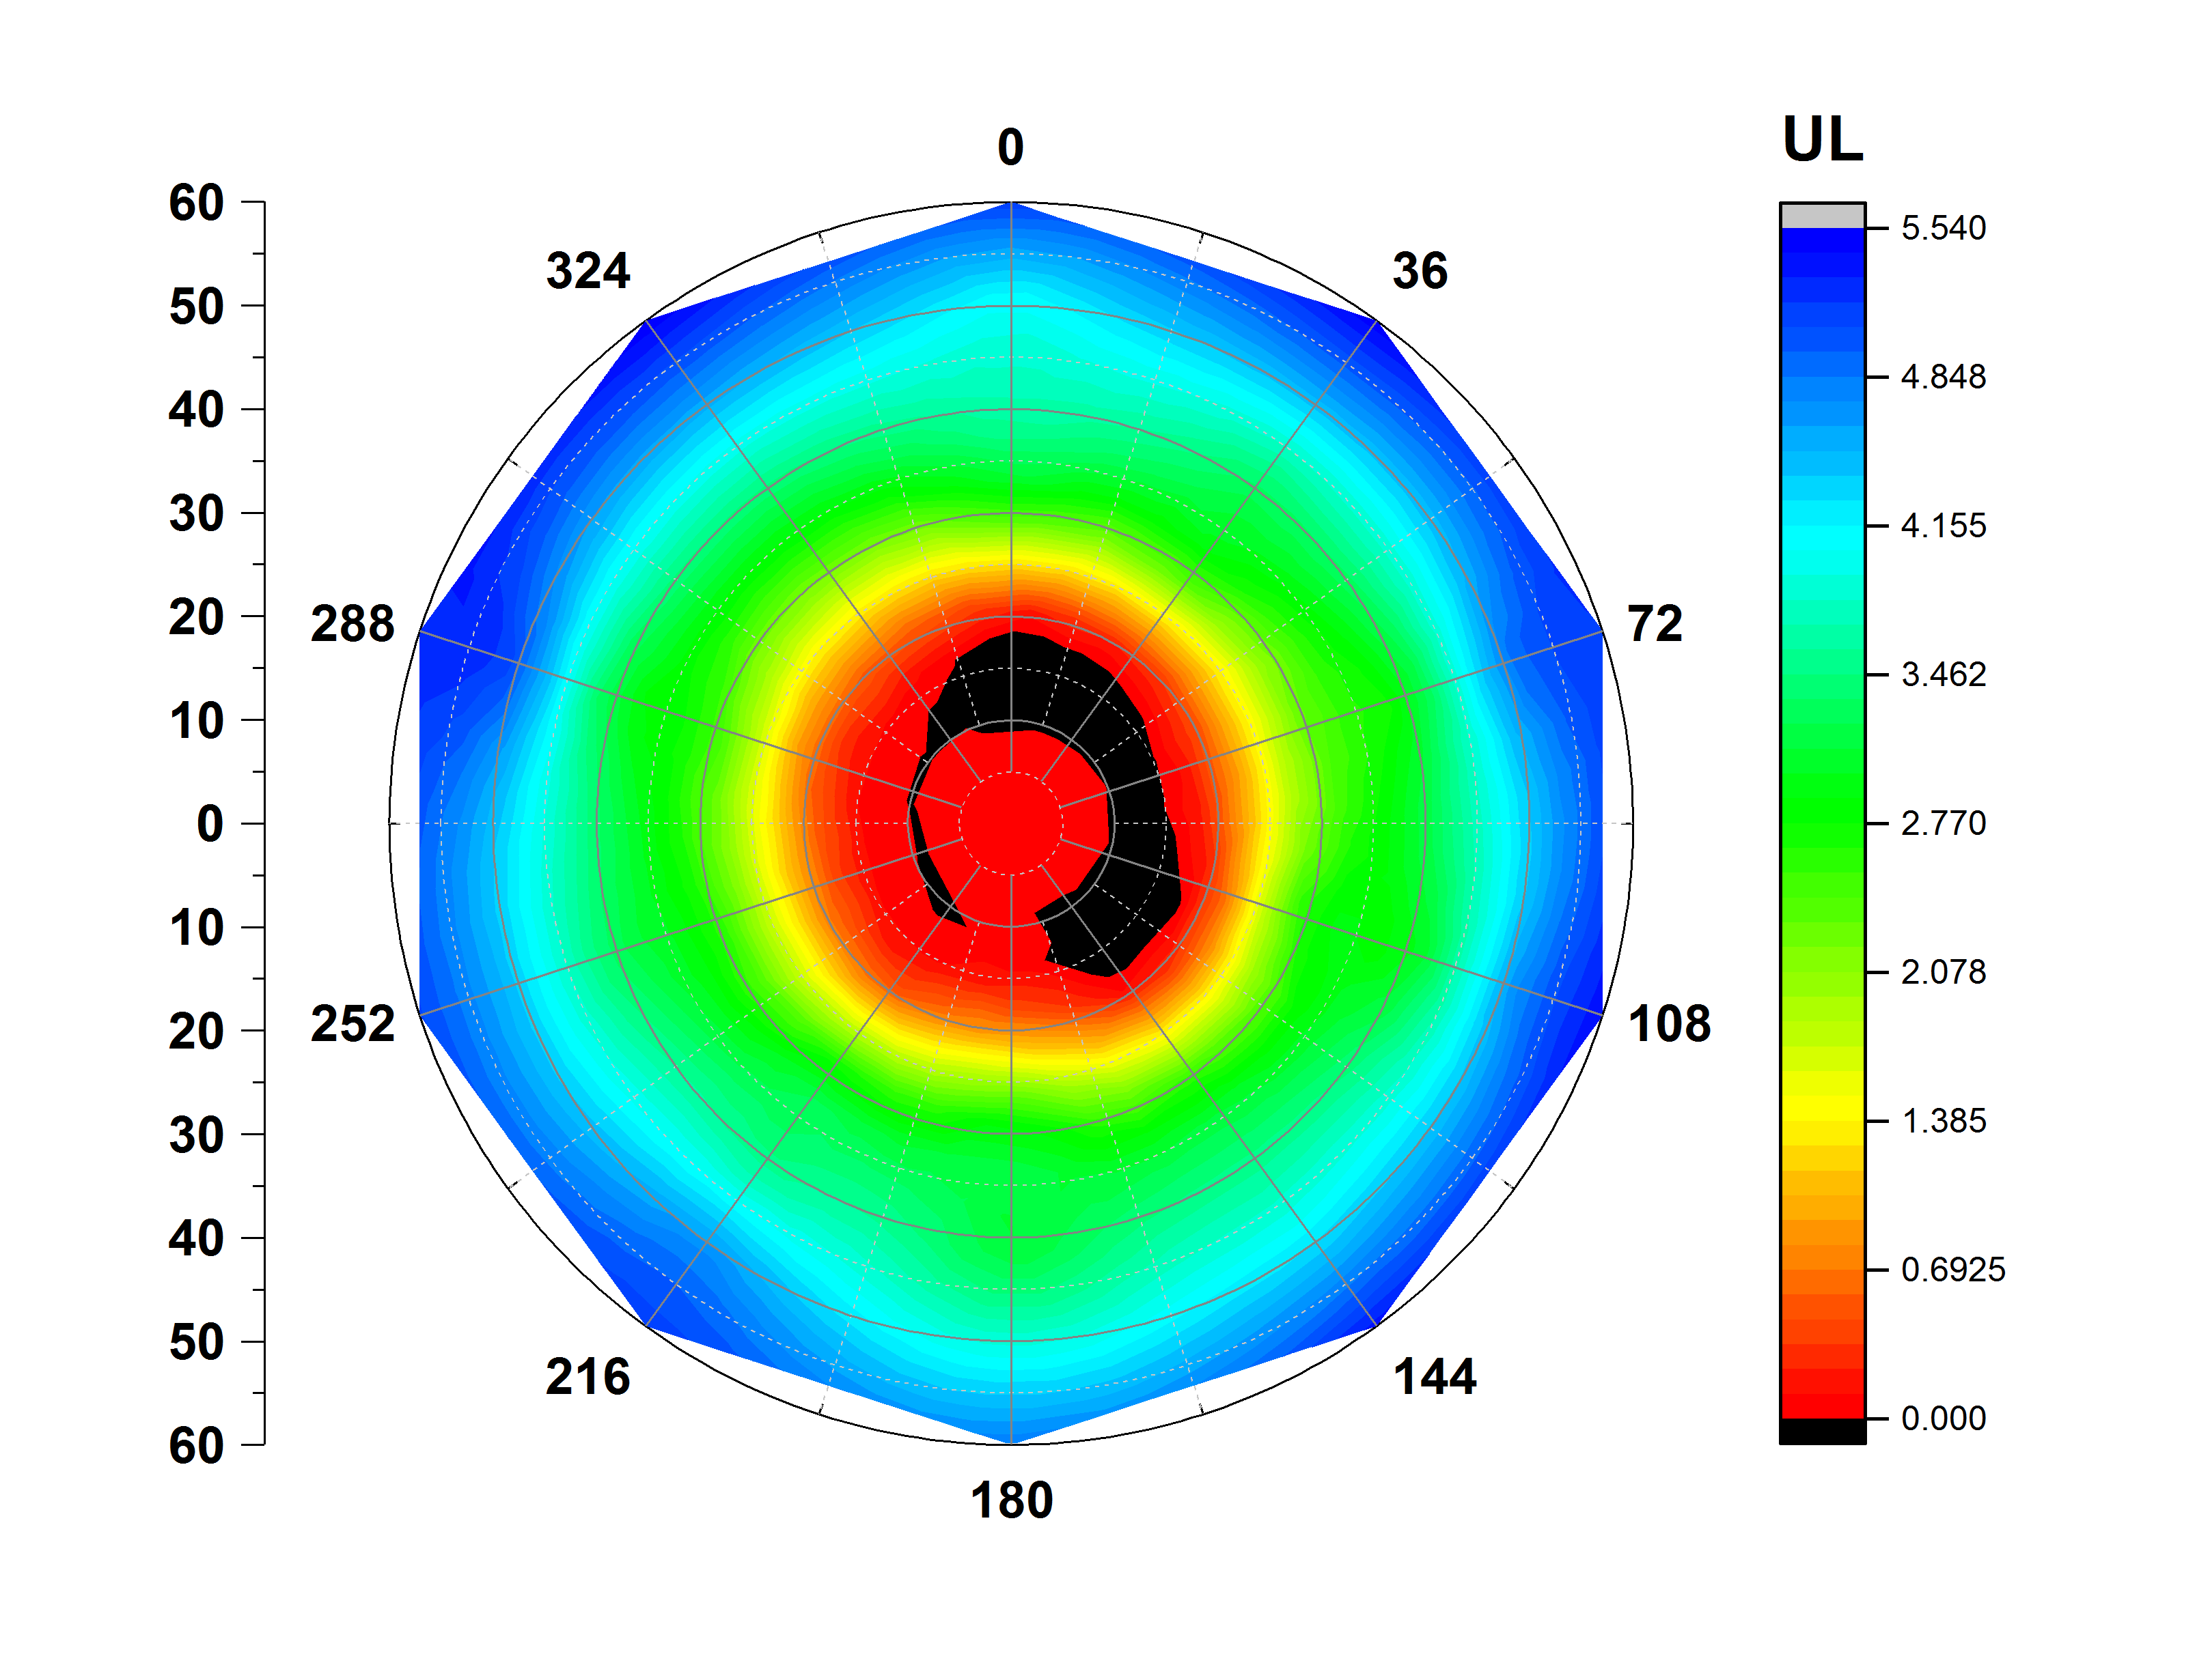
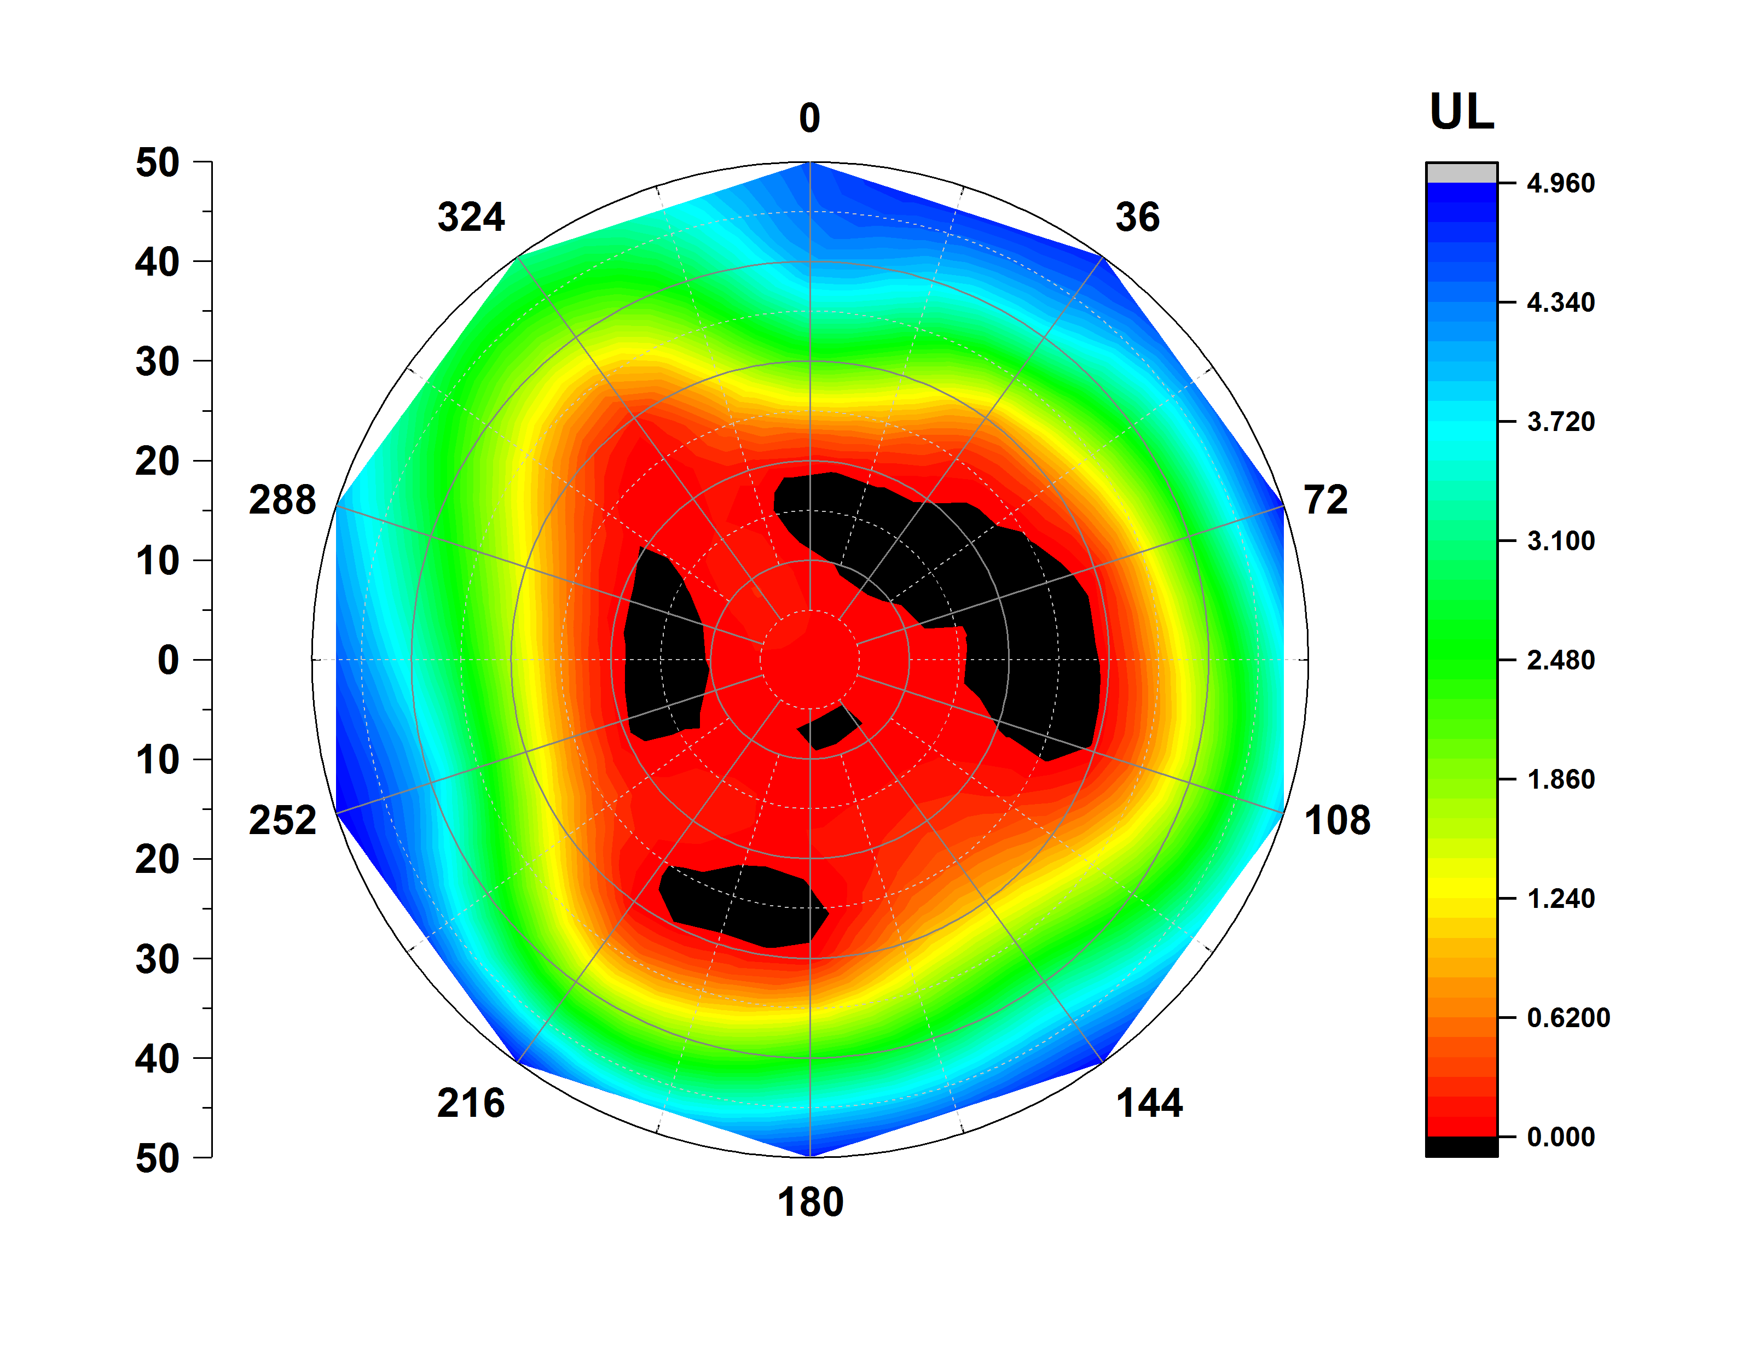
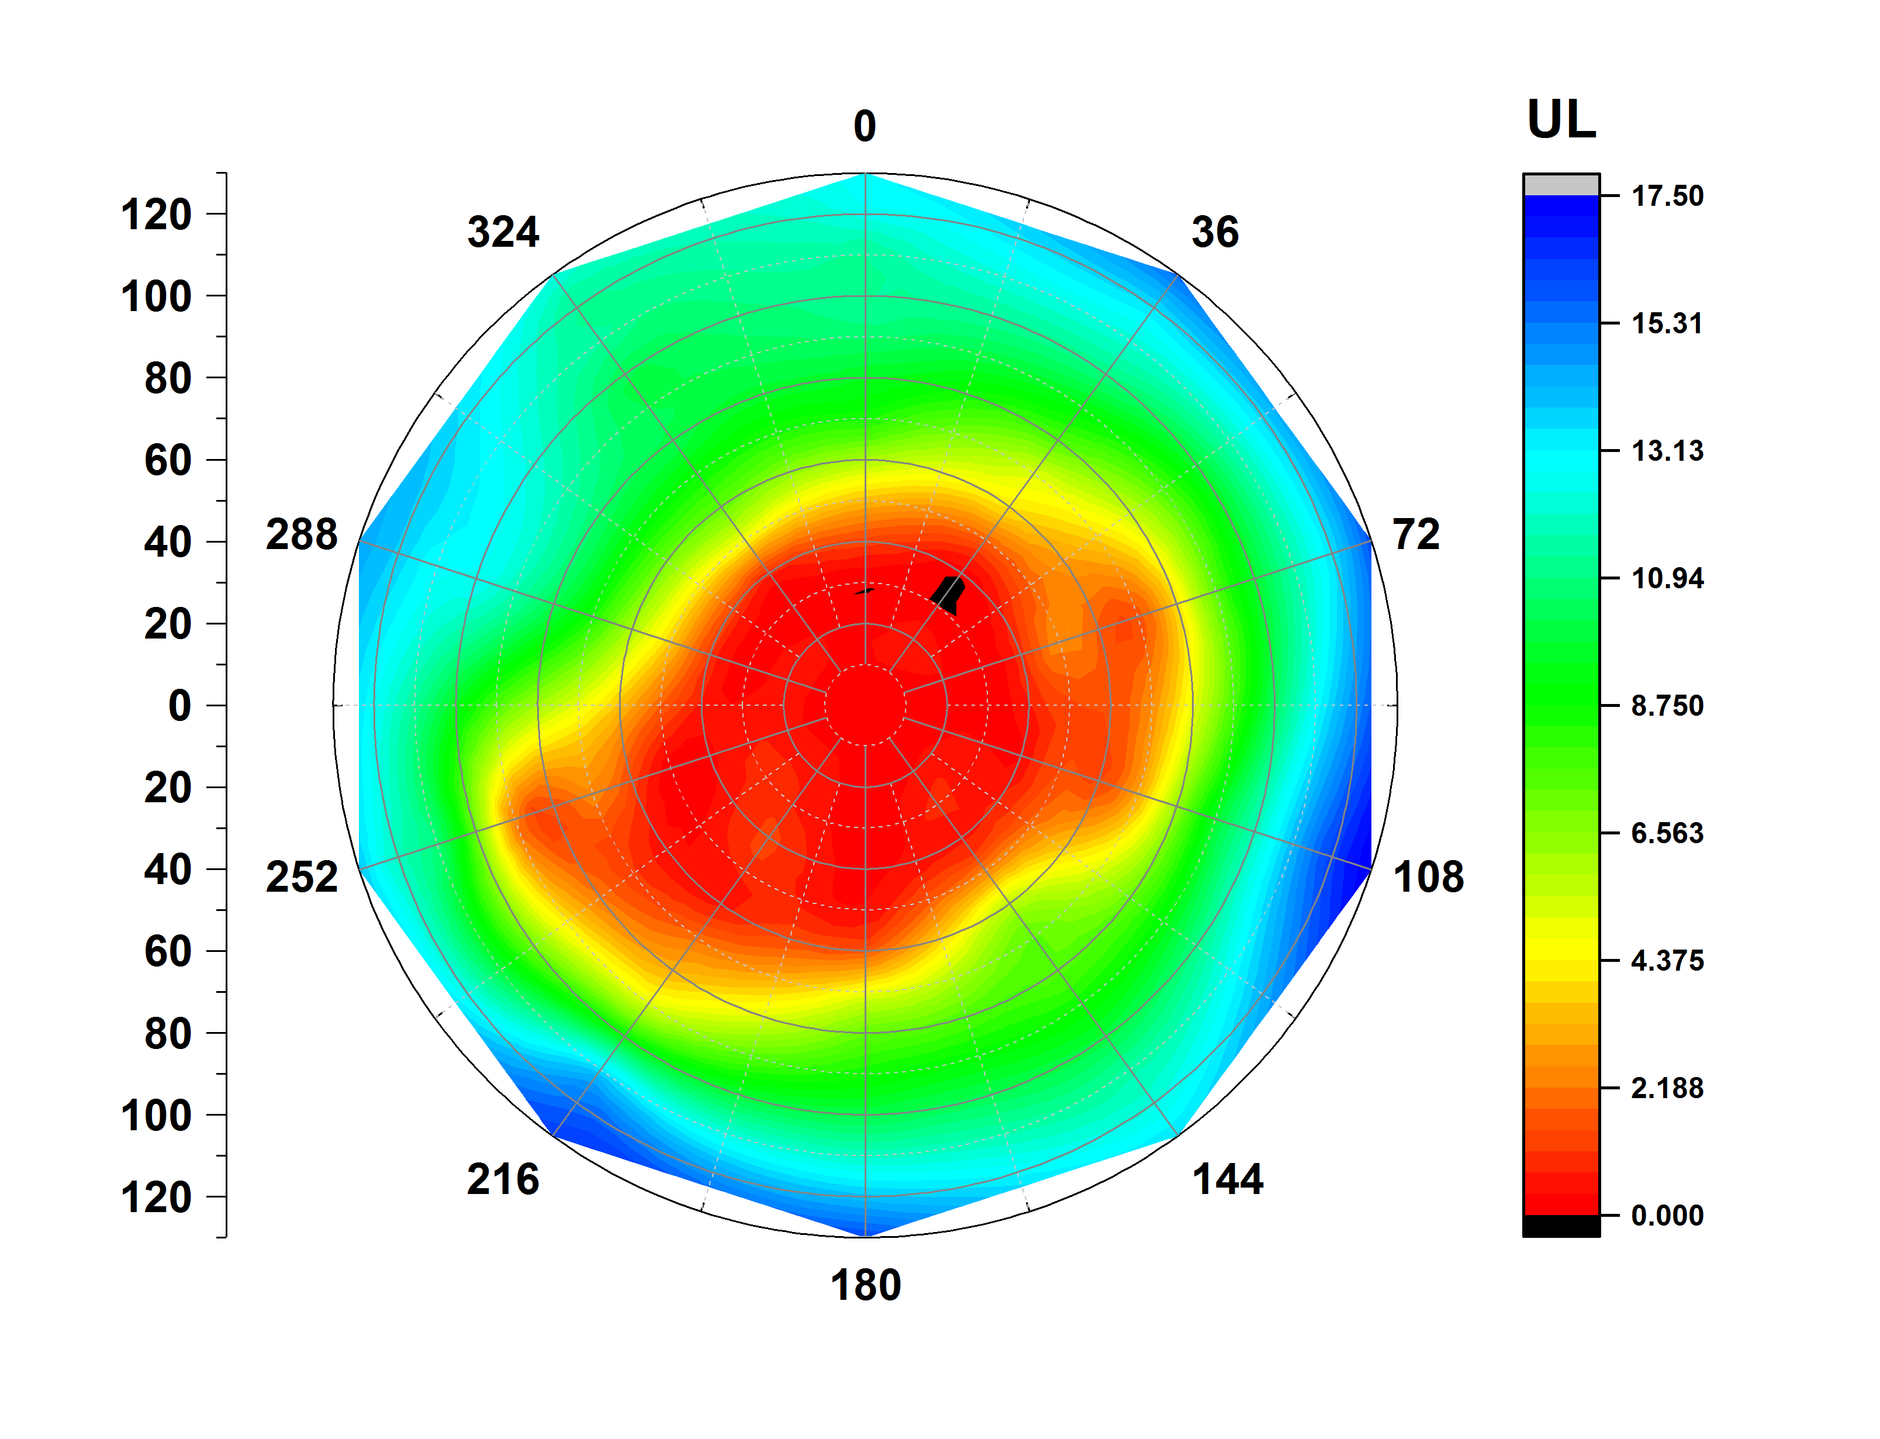
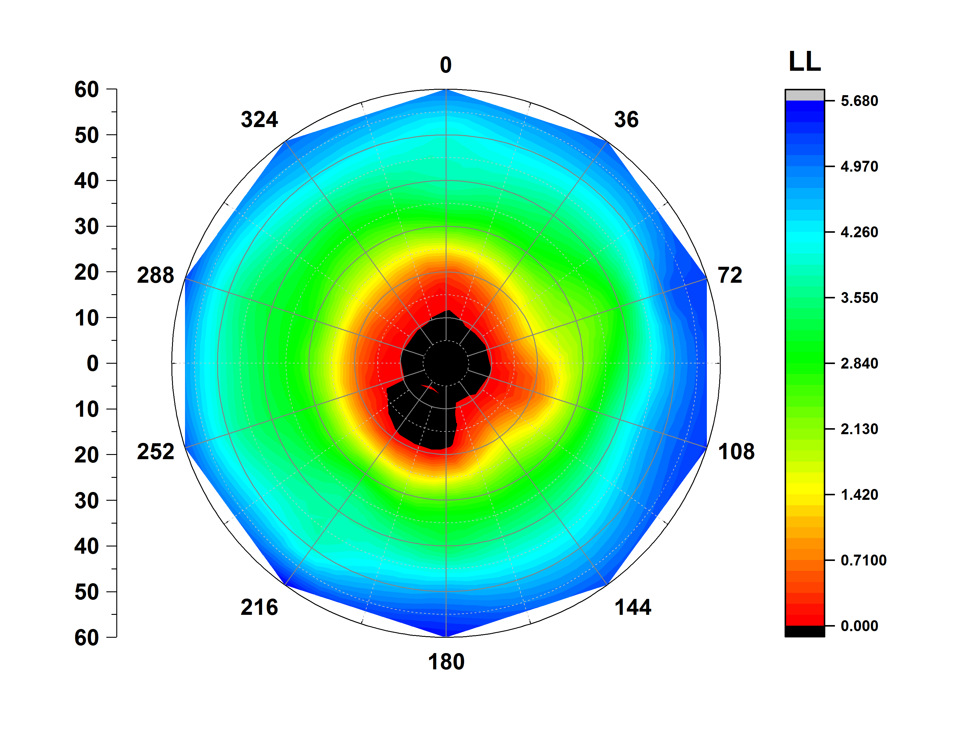
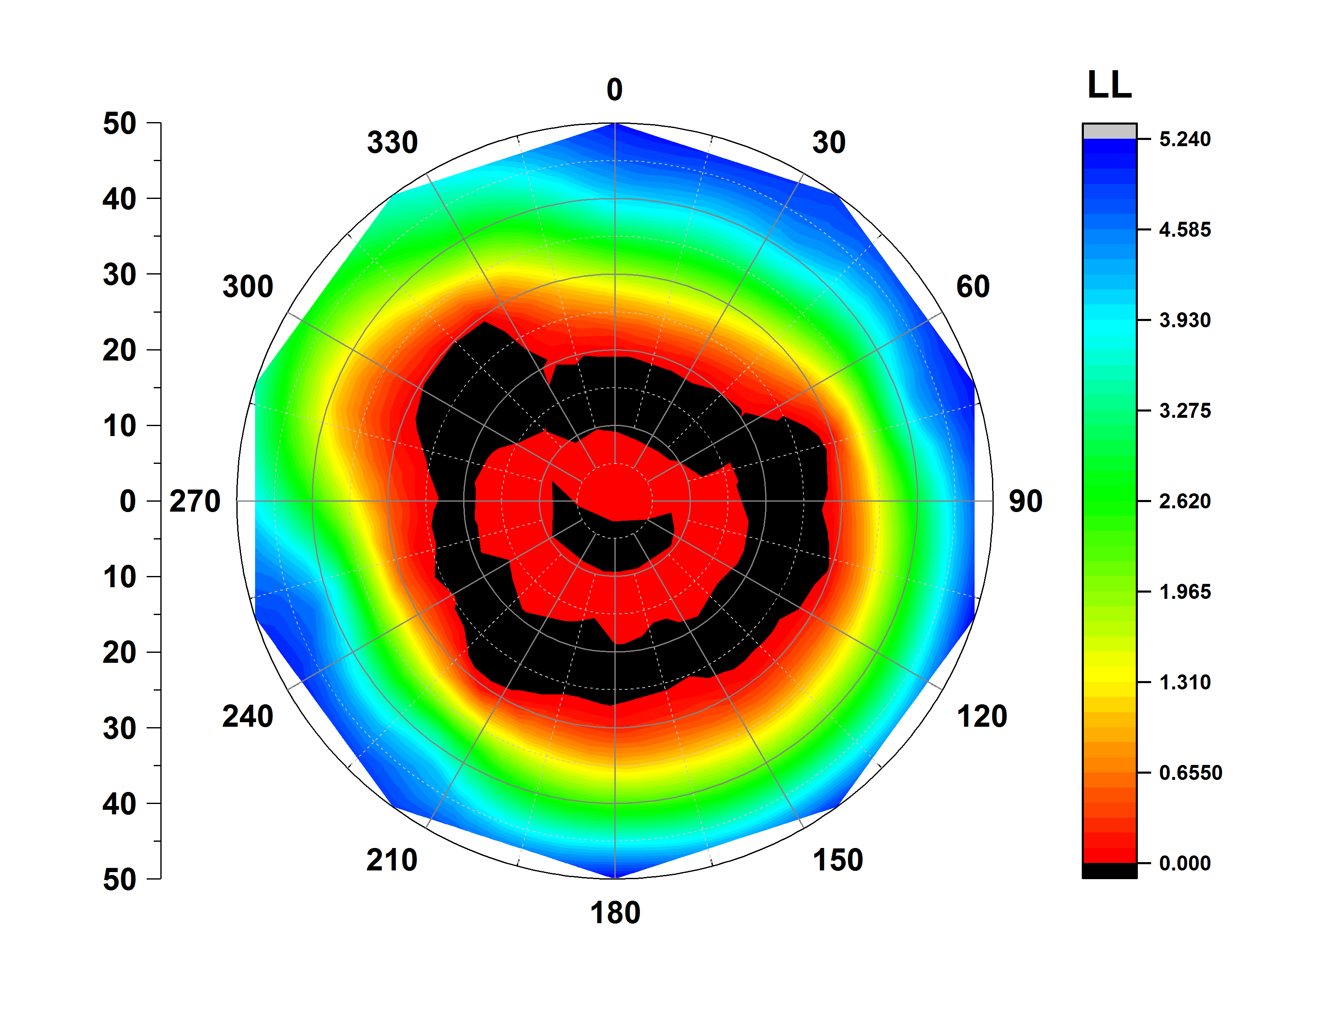
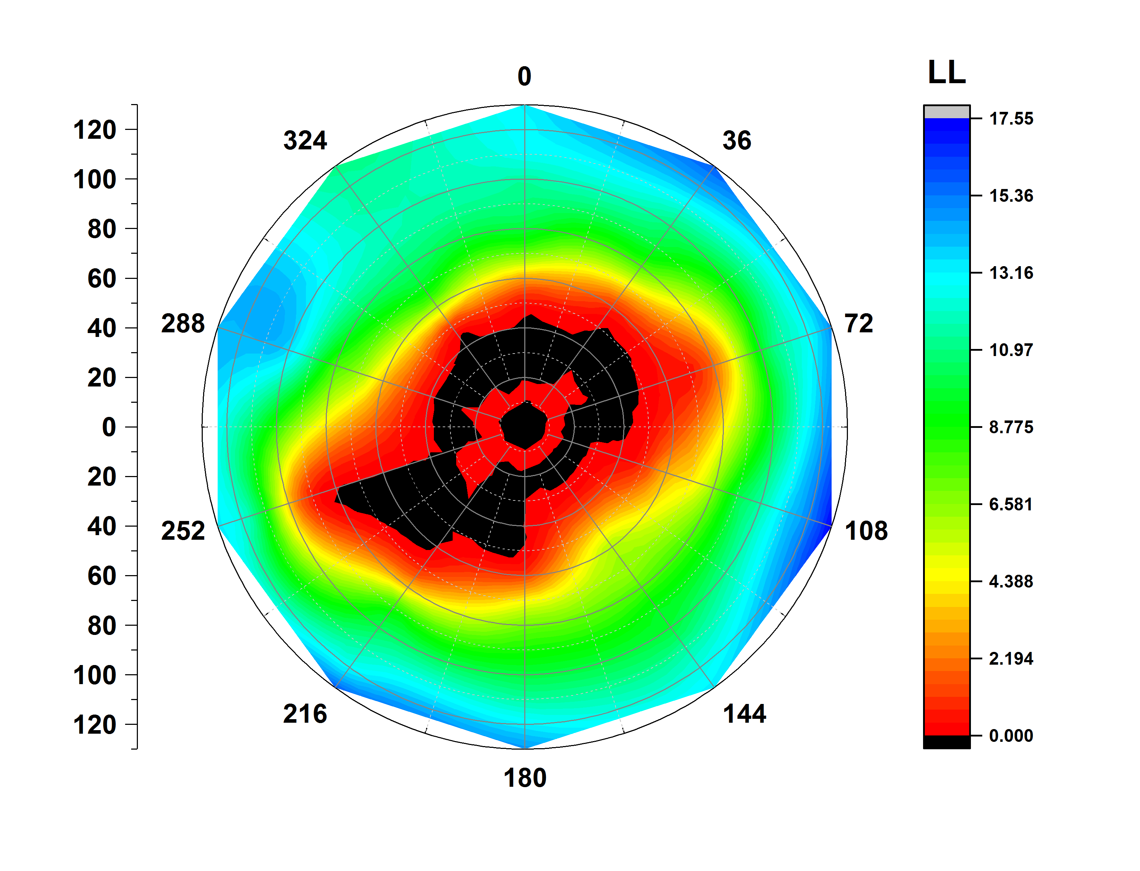
Lipid profile in contrast to protein profile
CXCR4 CHEMOKINE RECEPTOR (3ODU)
ATP SYNTHASE (1C17)
PHOTOSYSTEM 2 ( 3WU2)
UPPER LEAFLET
LOWER LEAFLET

Slide 12
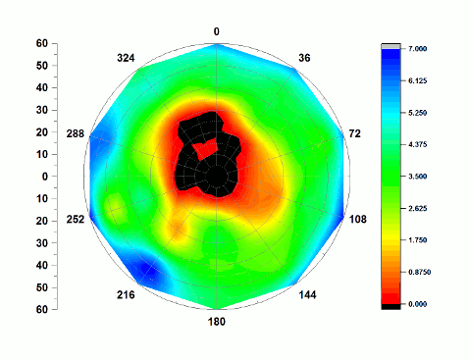
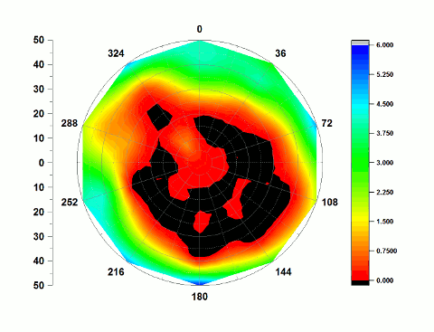
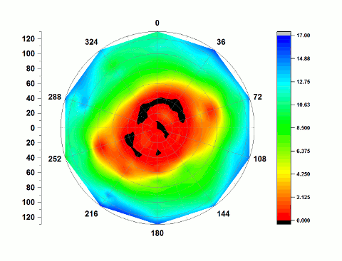
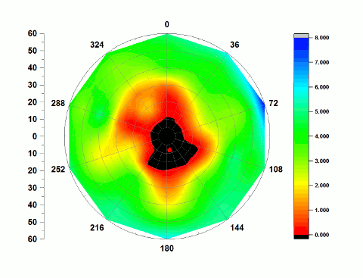
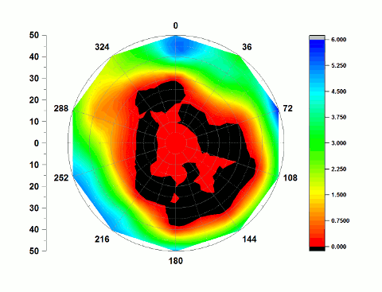
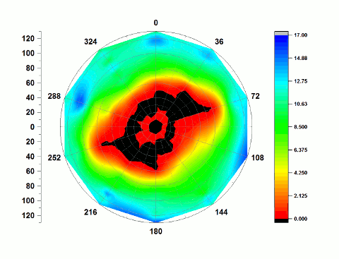
Lipid structure evolution
CXCR4 CHEMOKINE RECEPTOR (3ODU)
ATP SYNTHASE (1C17)
PHOTOSYSTEM 2 ( 3WU2)
UPPER LEAFLET
LOWER LEAFLET

Slide 13
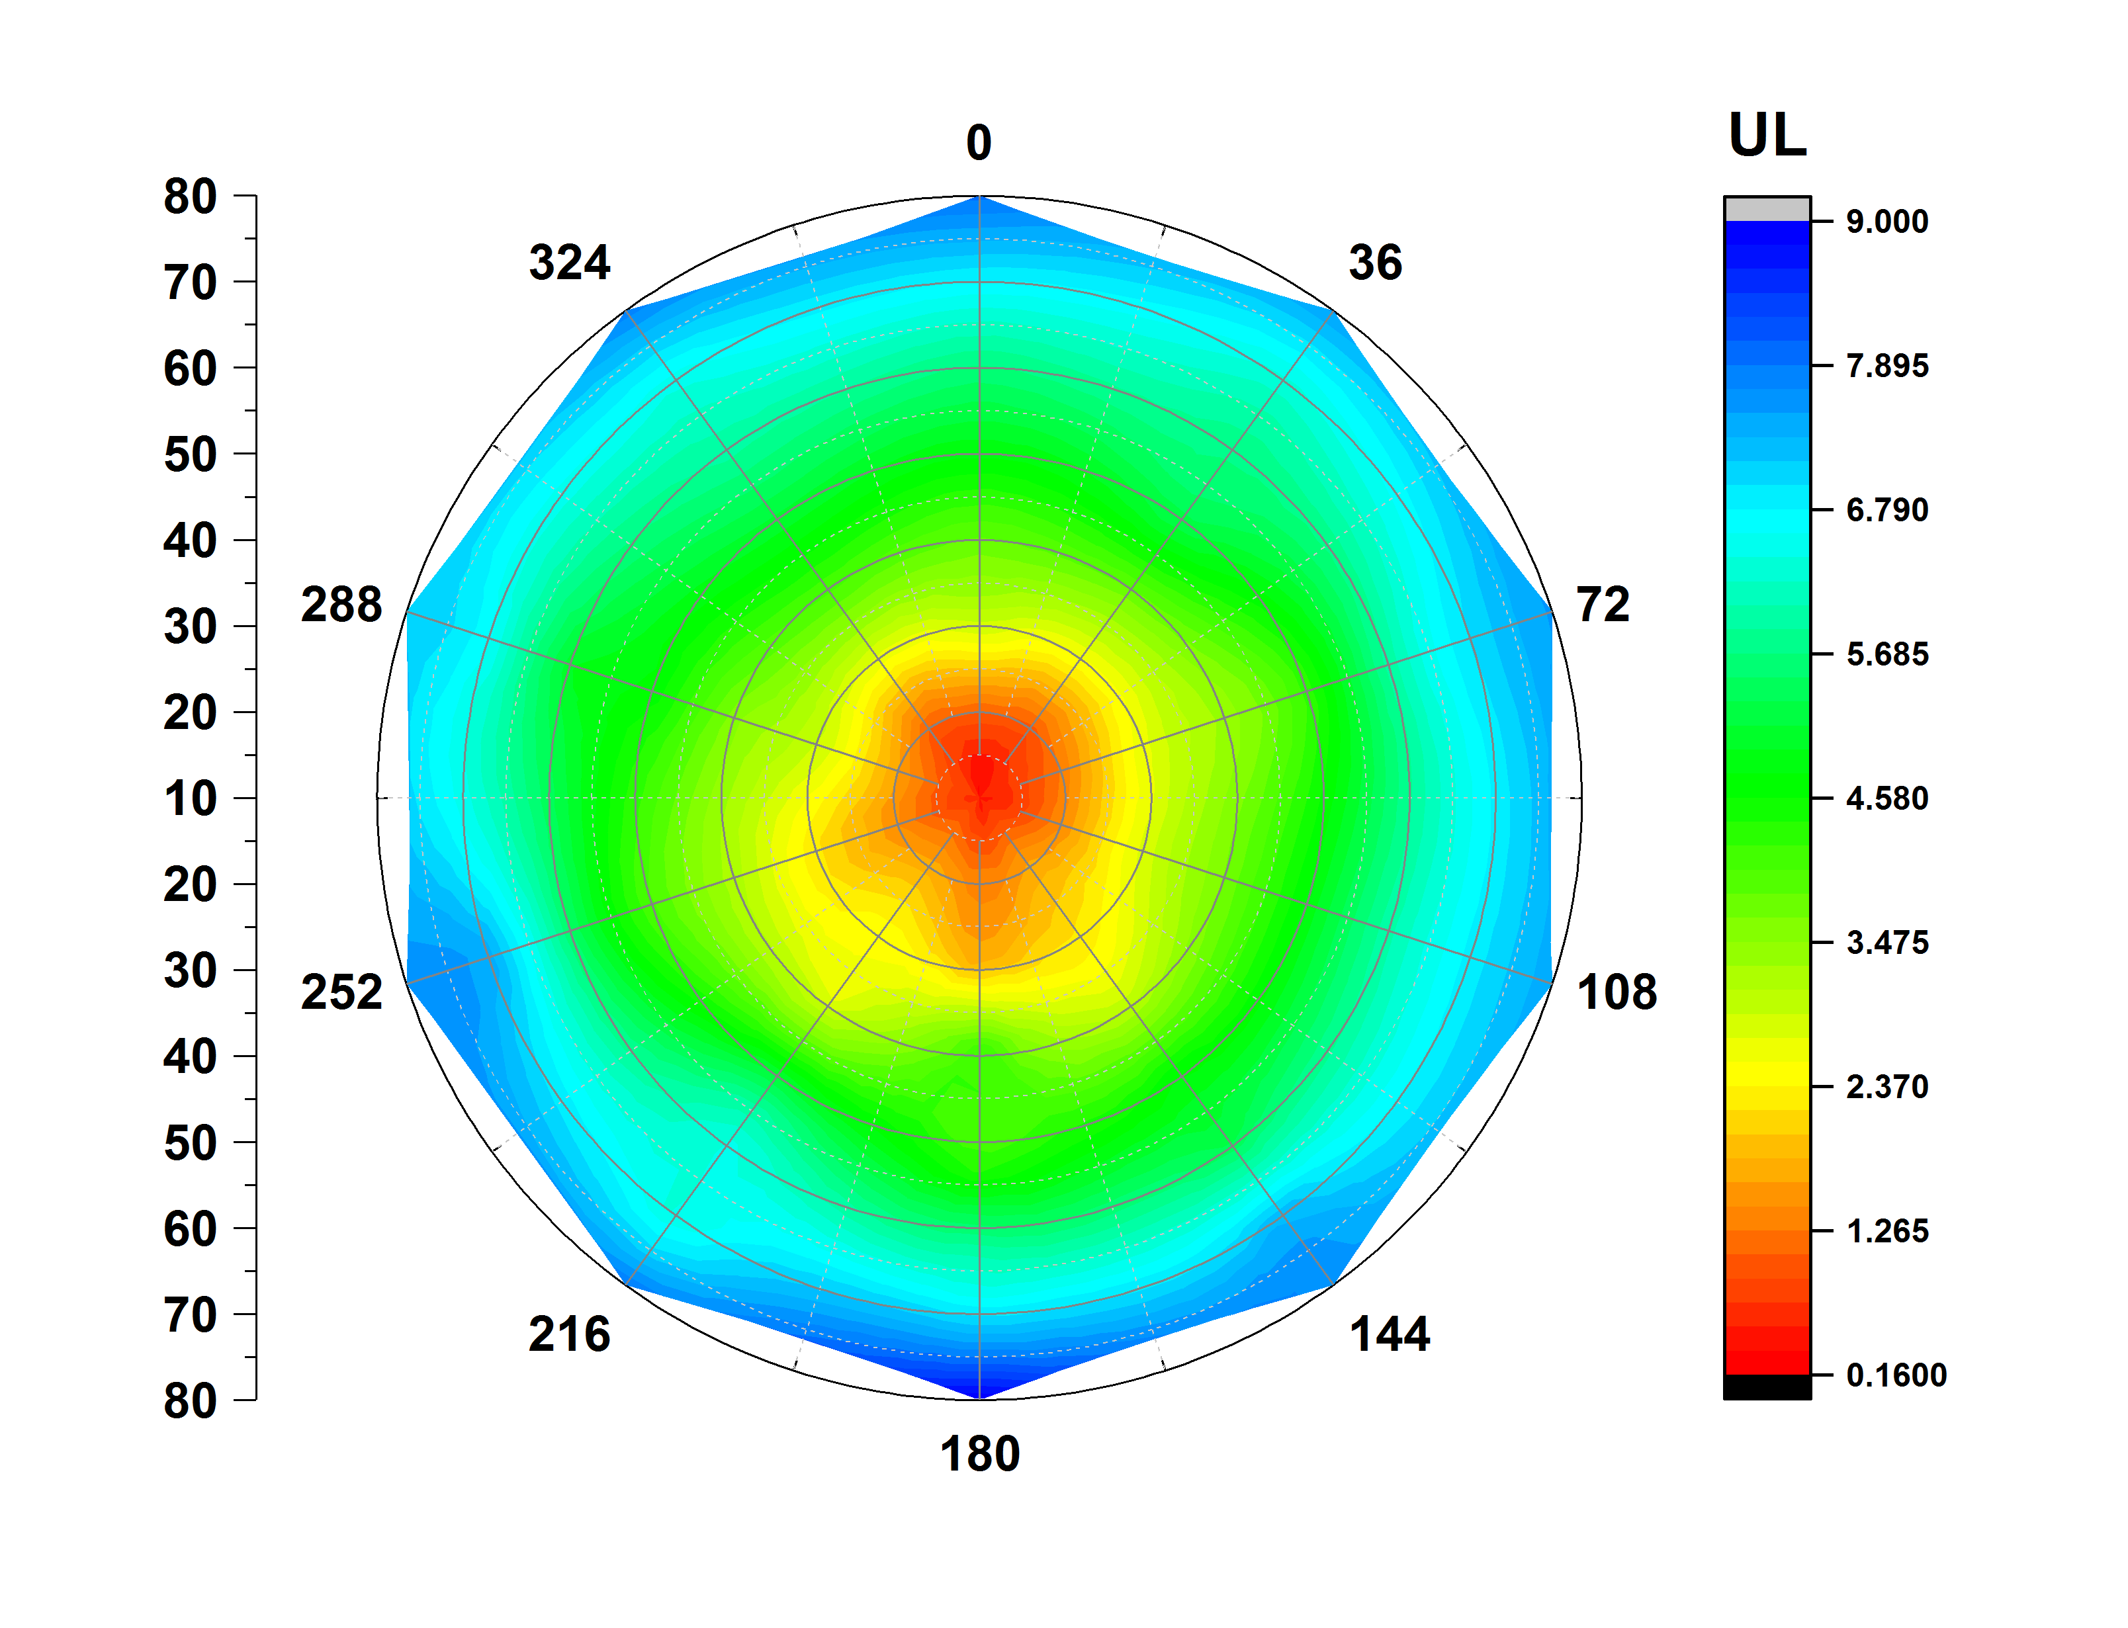
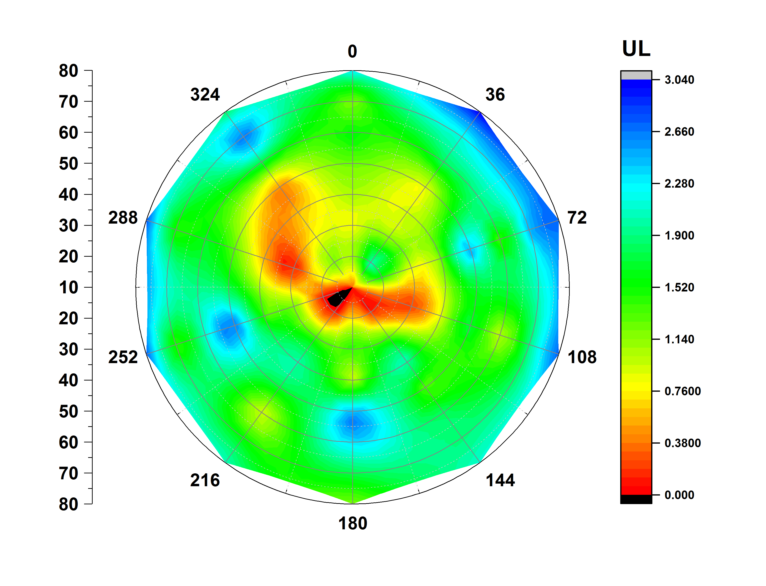
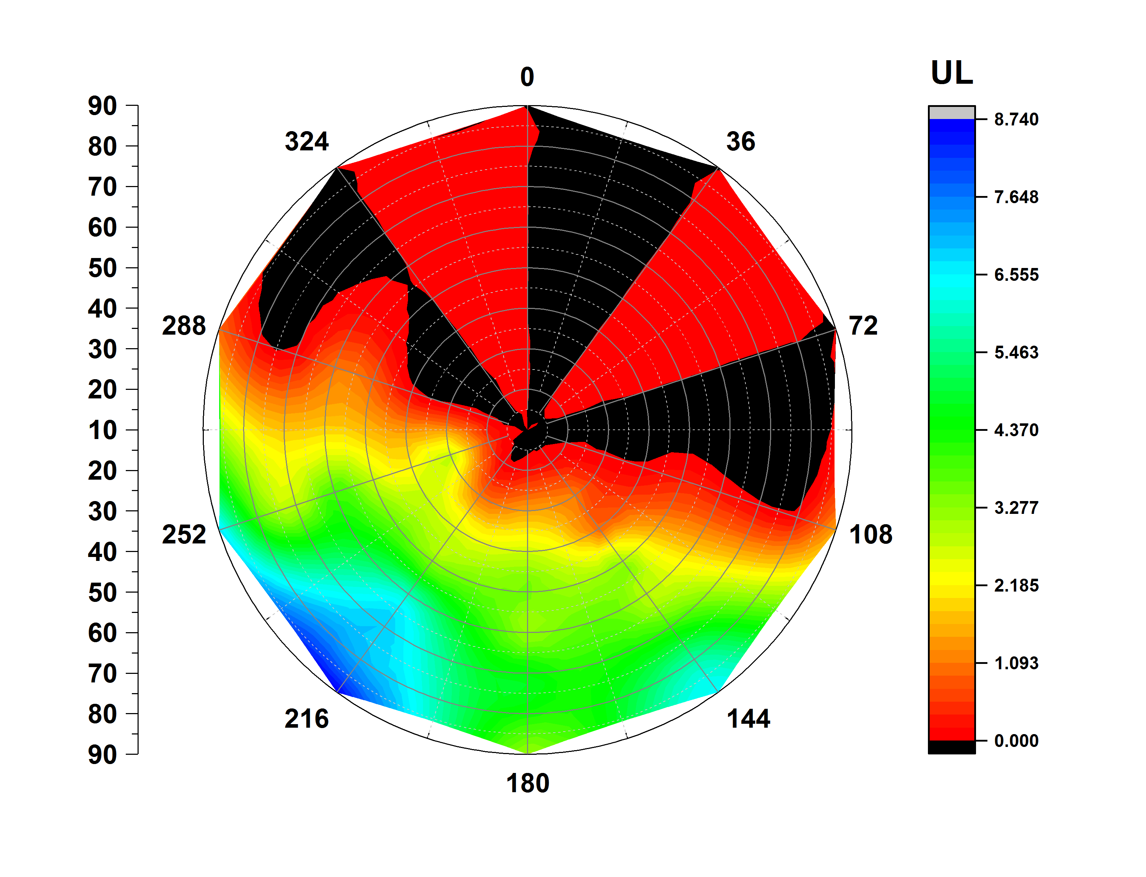
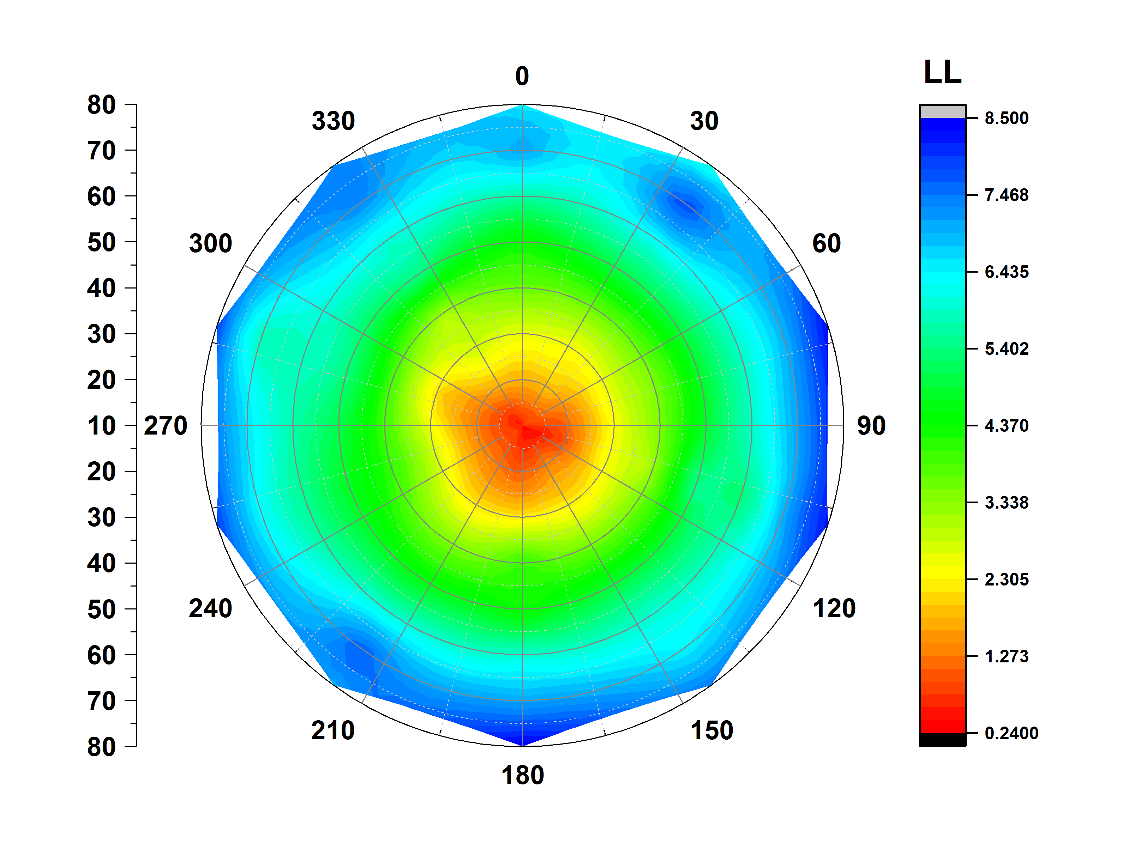
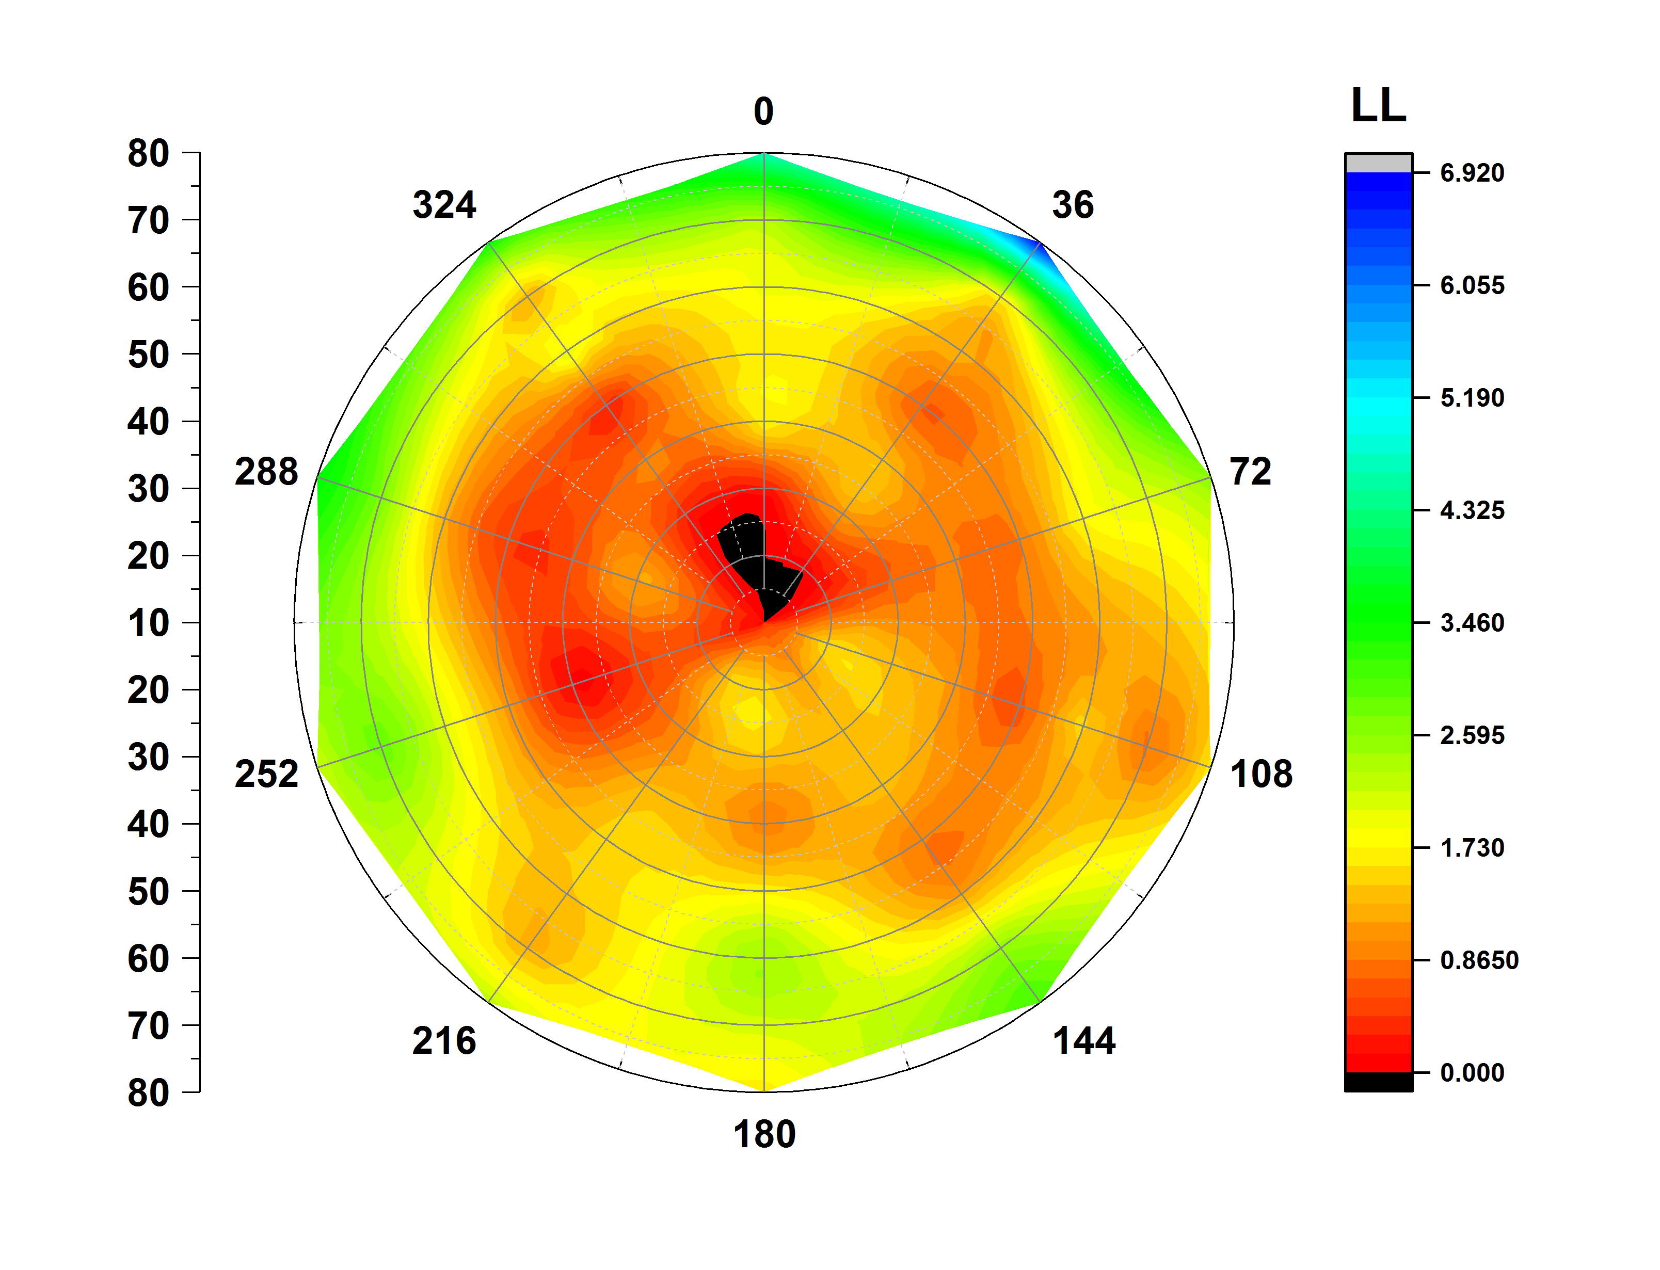
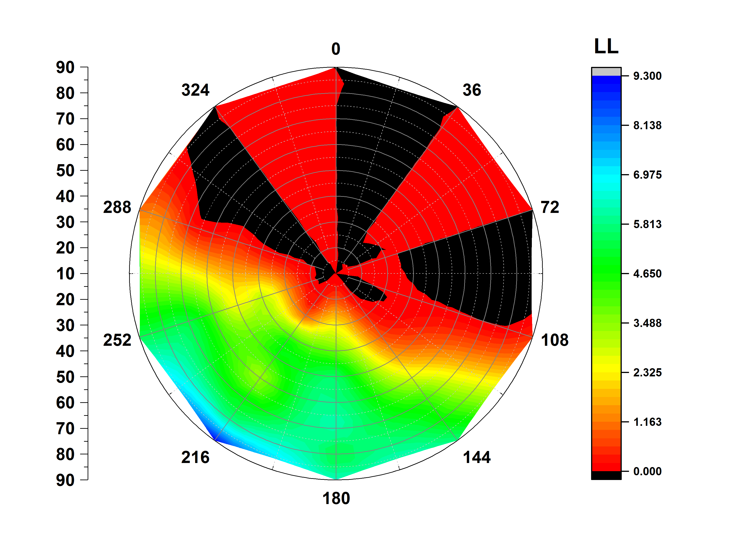
Asymmetric lipid bilayer (POPC/CHL)
AVERAGED OVER 100ns OF MOLECULAR DYNAMICS SIMULATIONS (~ 1 month)
POPC
CHL
CHL
UPPER LEAFLET
LOWER LEAFLET
WELL SPREAD CHOLESTEROL
CHOLESTEROL DOMAIN

Slide 14
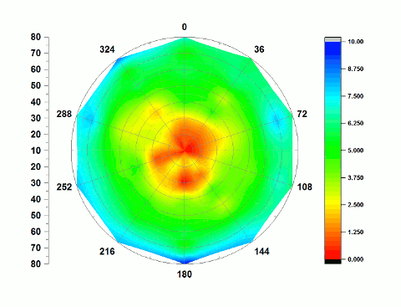
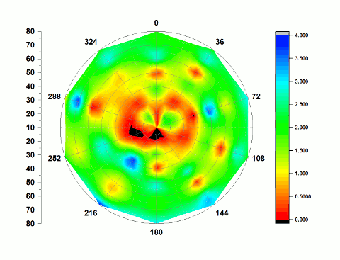
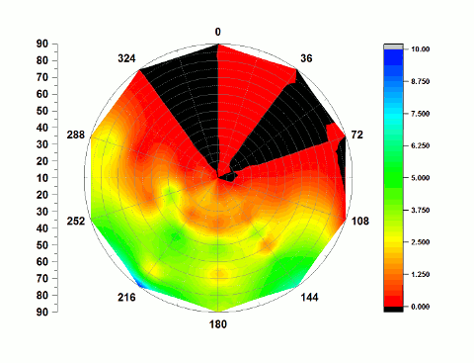
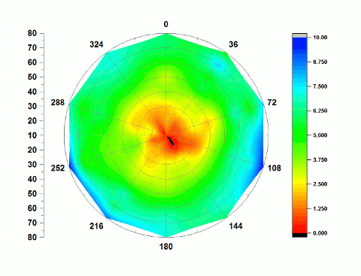
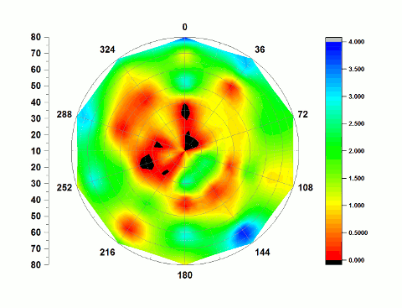
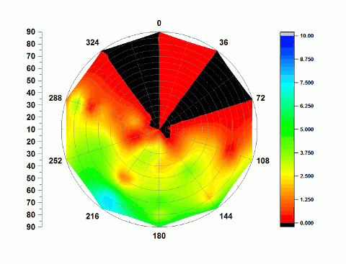
Time evolution
100ns OF MOLECULAR DYNAMICS SIMULATIONS (~ 1 month)
POPC
CHL
CHL
UPPER LEAFLET
LOWER LEAFLET
WELL SPREAD CHOLESTEROL
CHOLESTEROL DOMAIN

Slide 16
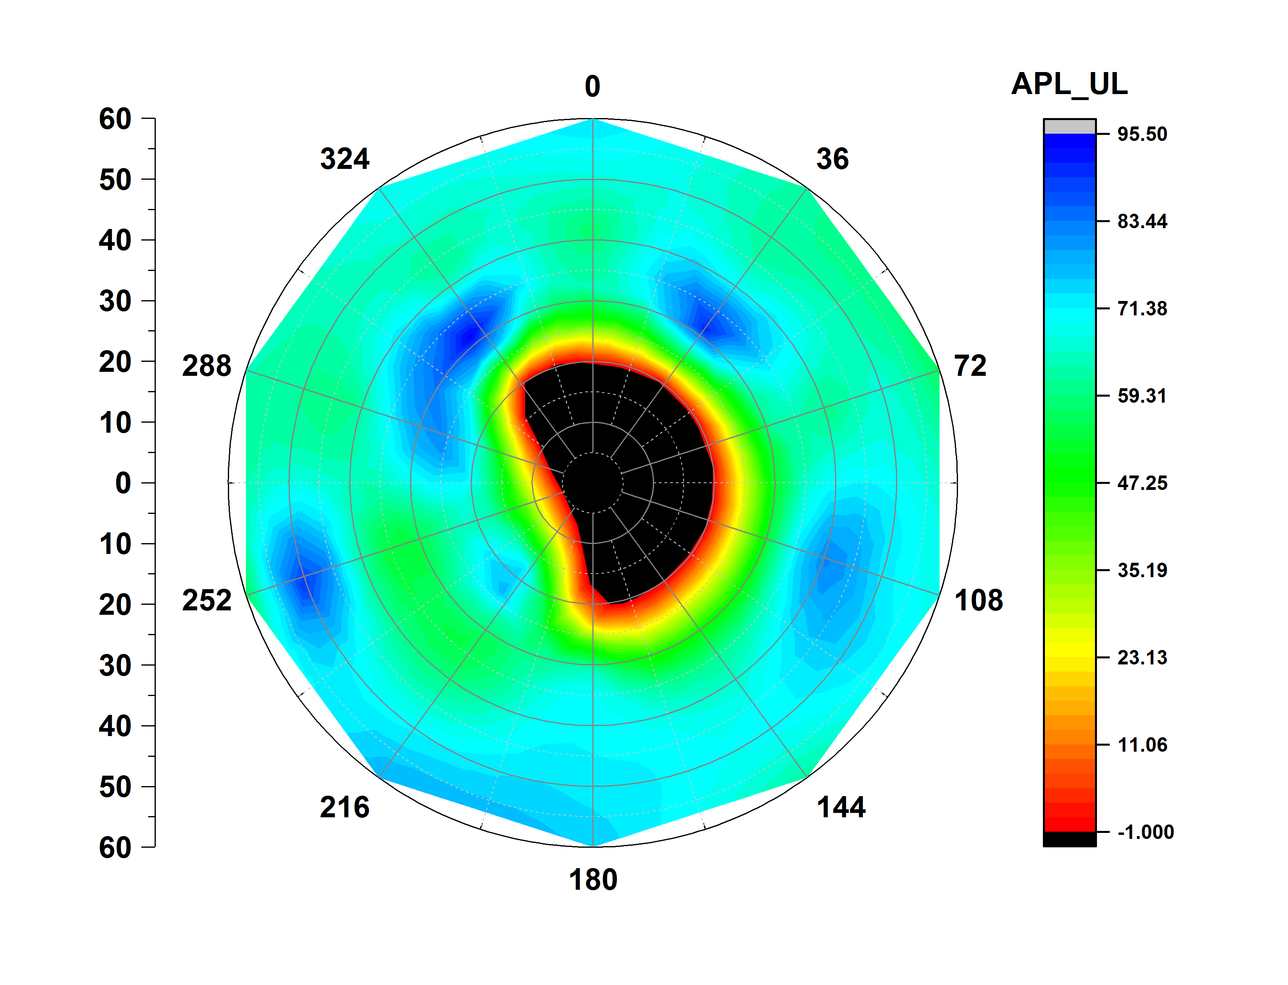
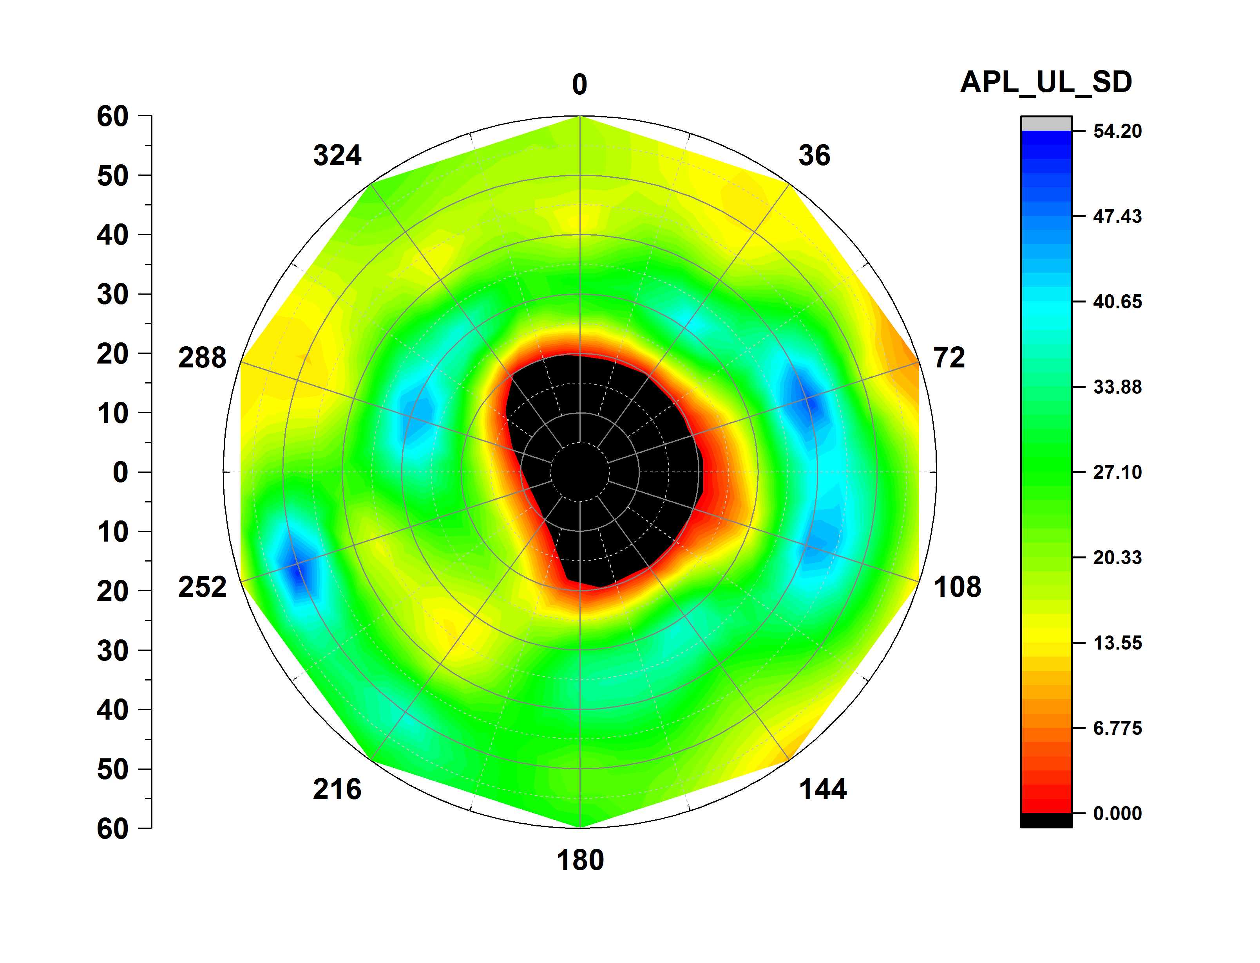
Area per lipid upper leaflet
CXCR4 CHEMOKINE RECEPTOR (3ODU)
ATP SYNTHASE (1C17)
PHOTOSYSTEM 2 ( 3WU2)

Slide 17
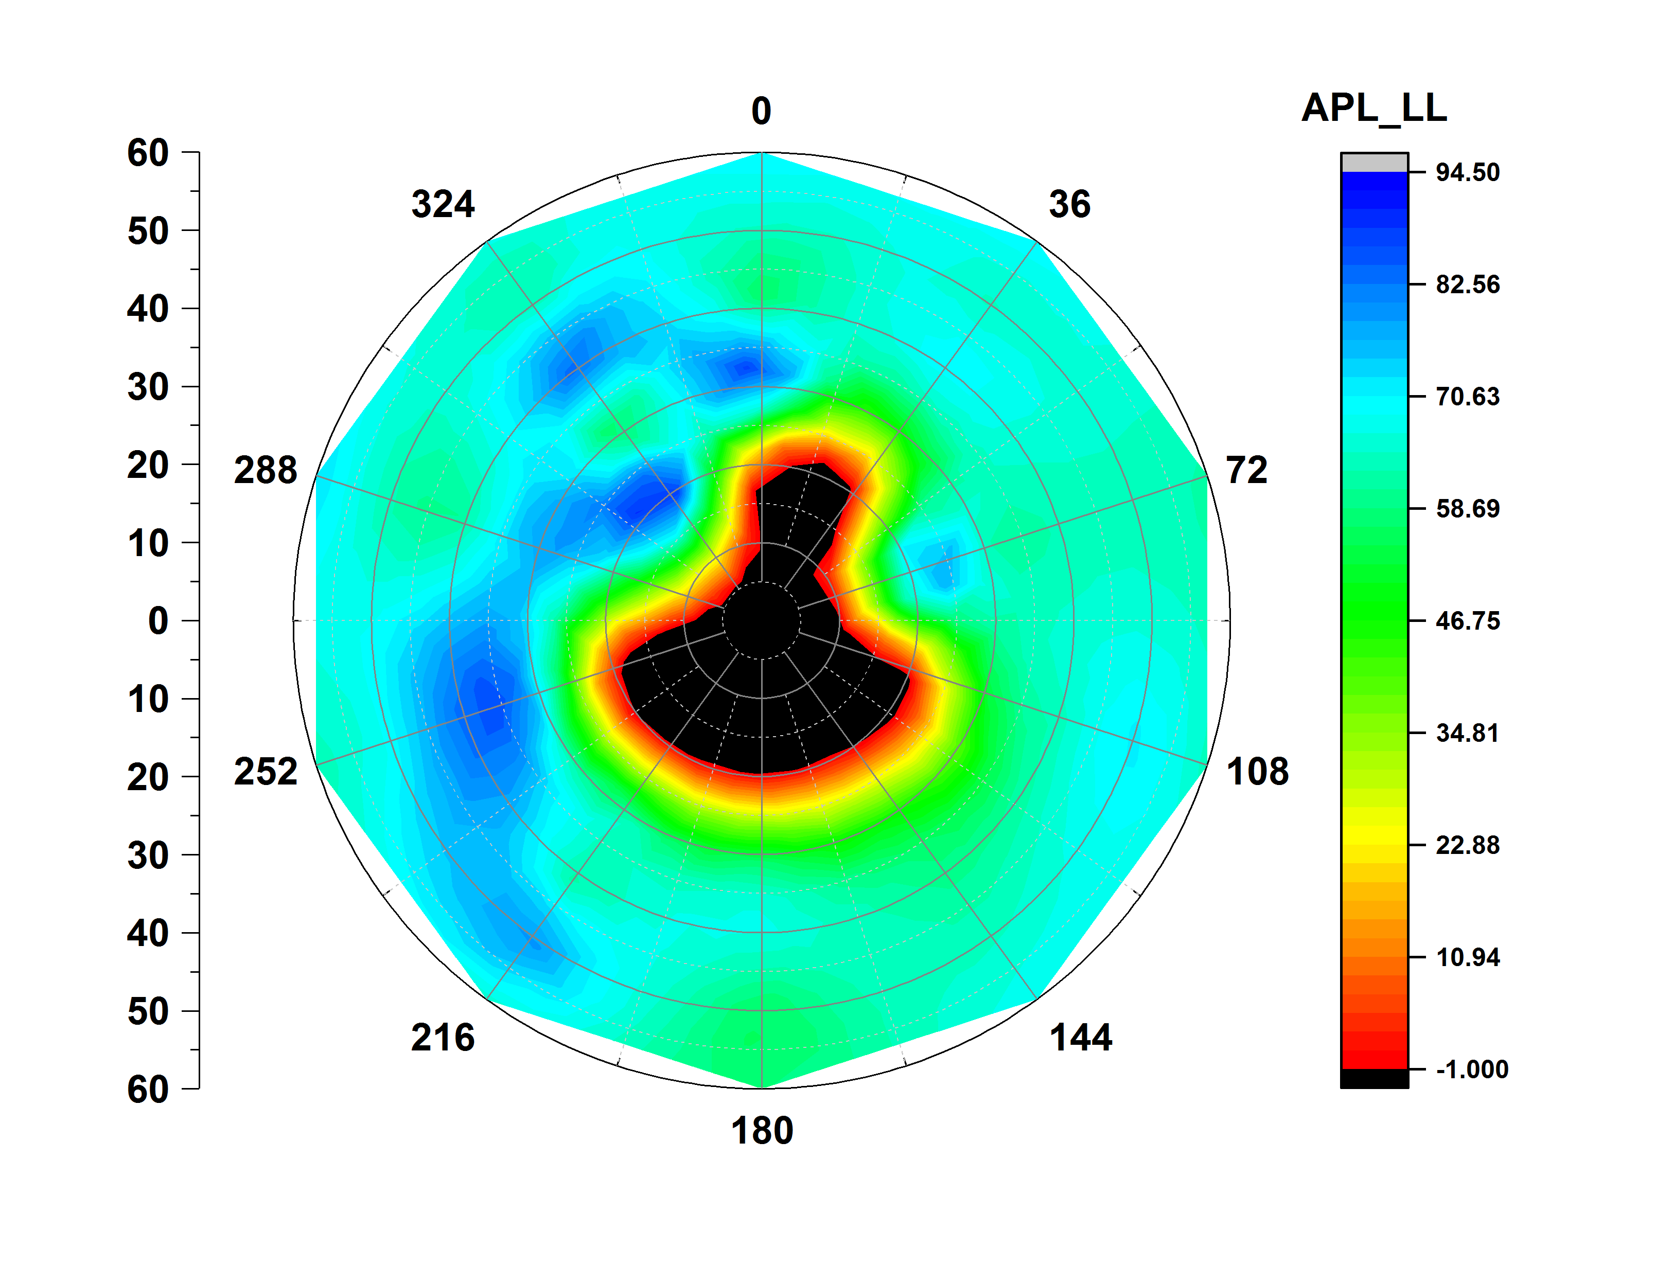
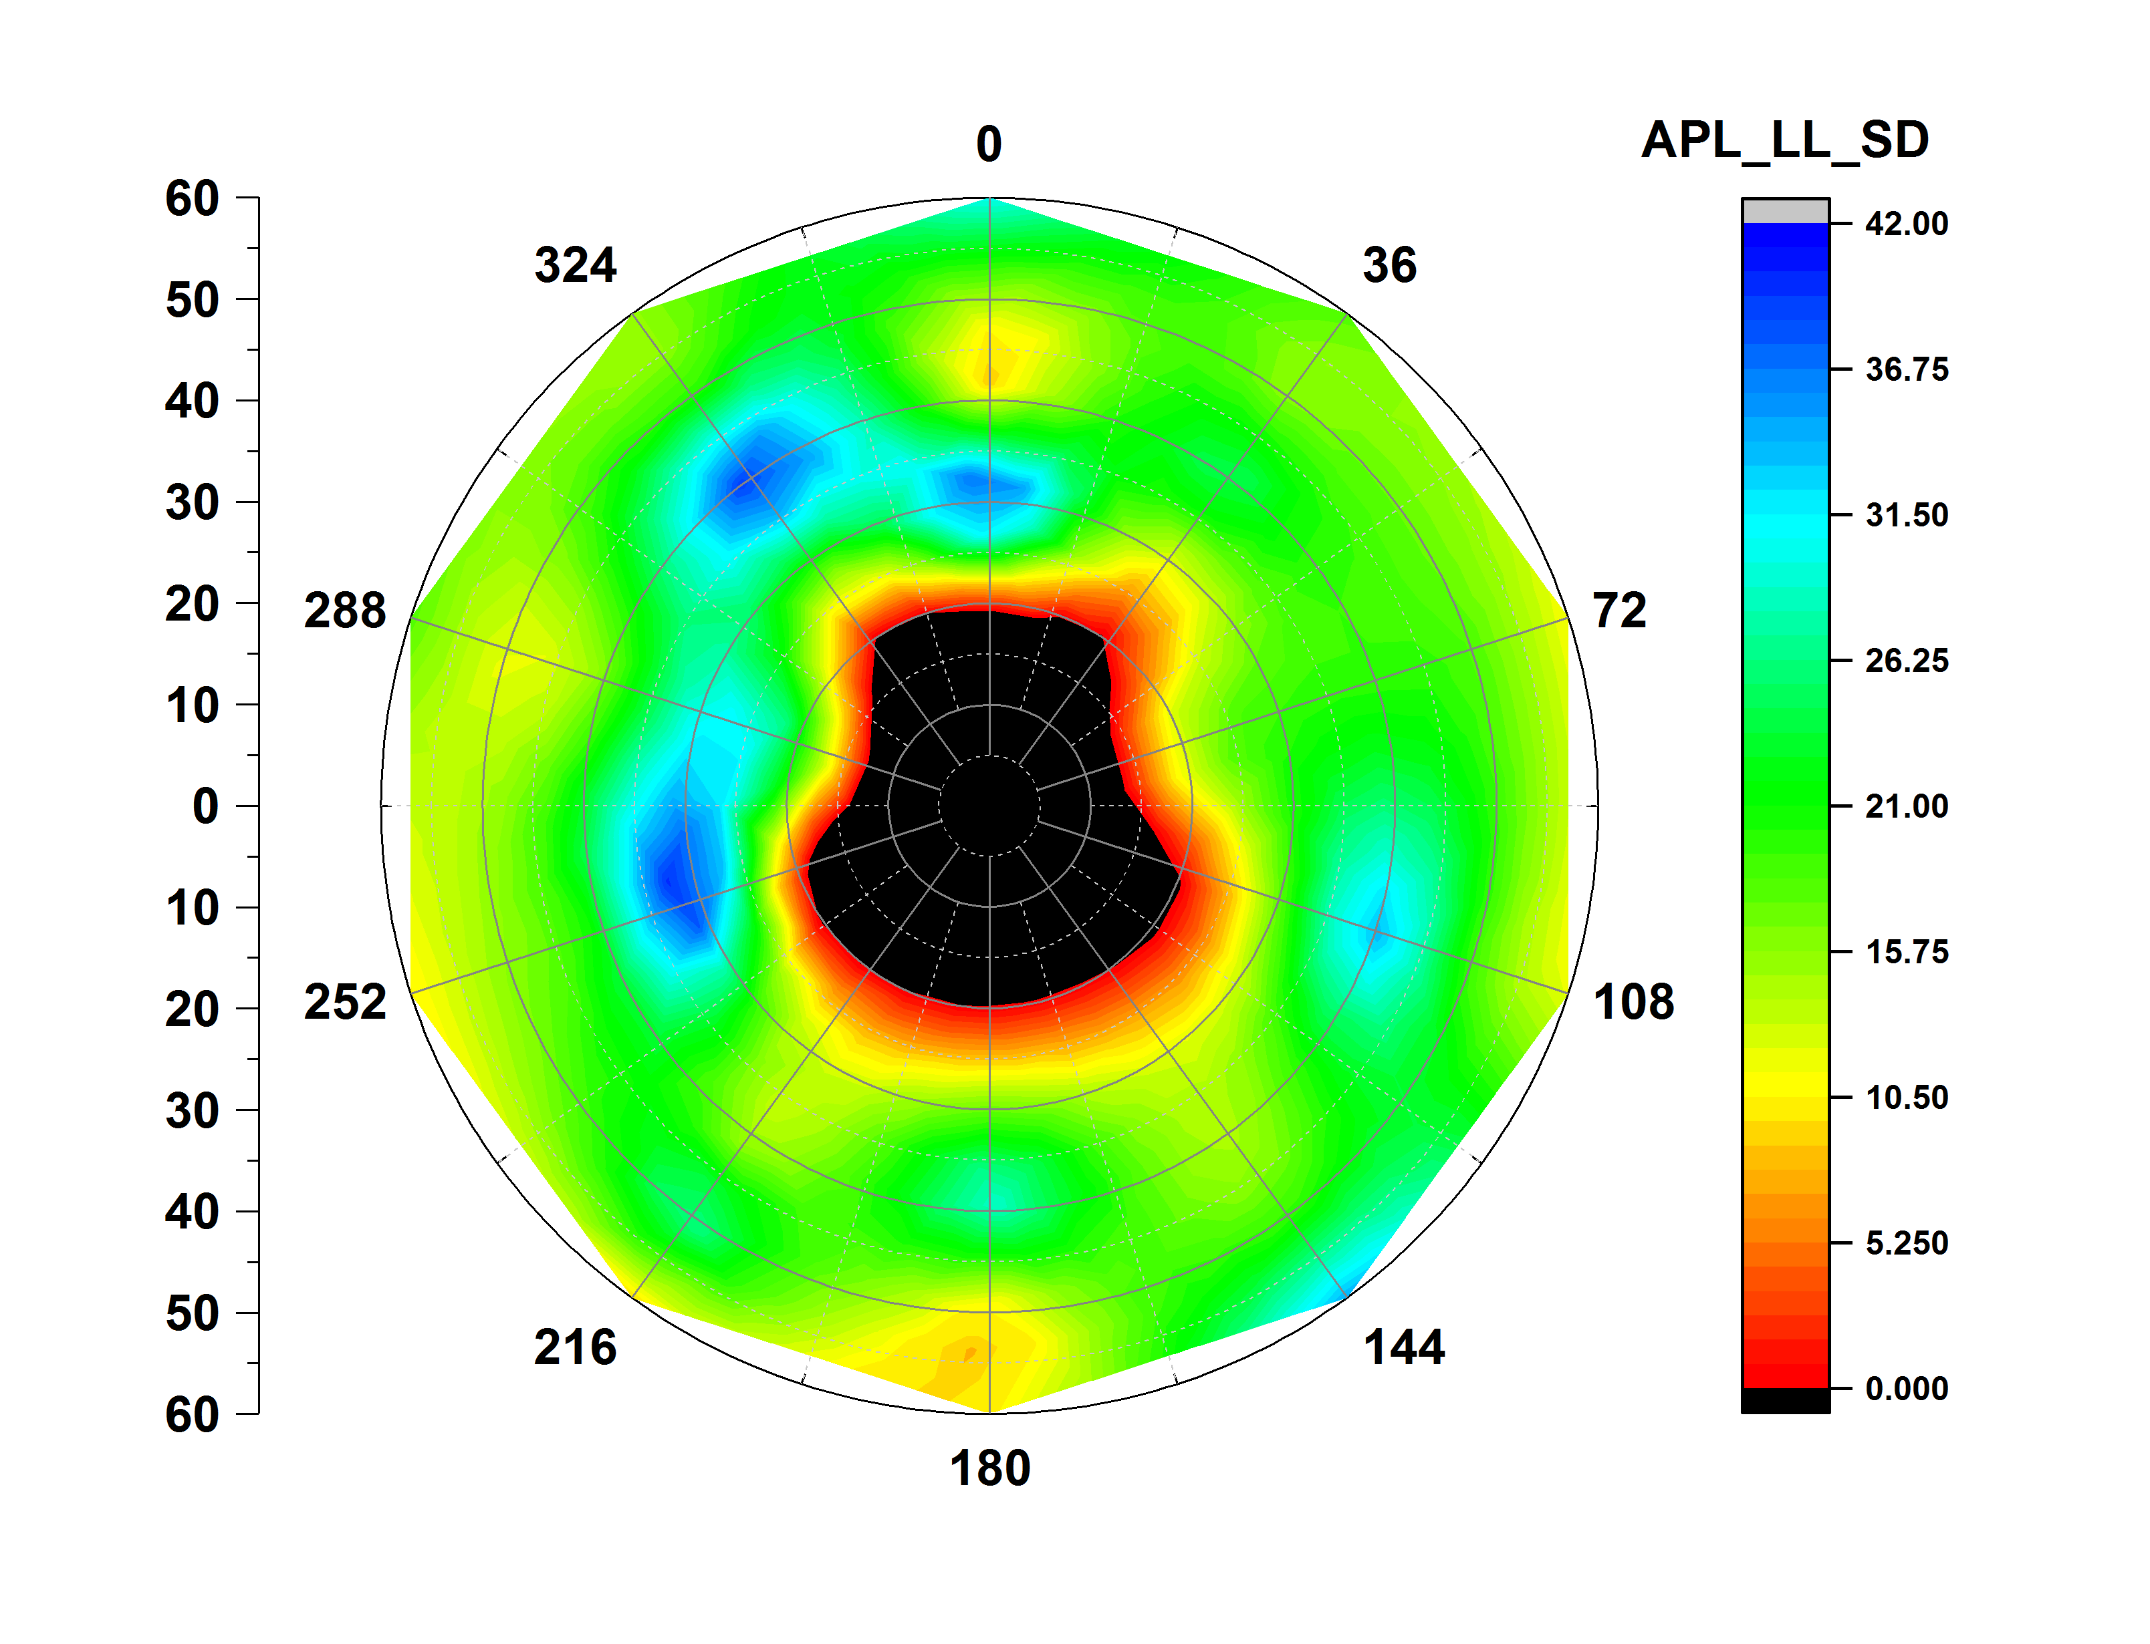
Area per lipid lower leaflet
CXCR4 CHEMOKINE RECEPTOR (3ODU)
ATP SYNTHASE (1C17)
PHOTOSYSTEM 2 ( 3WU2)

